Slide 1



I’m still standing: research
By Mia Bainbridge

Slide 2
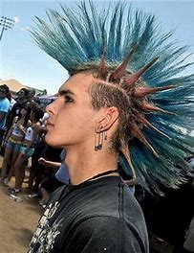

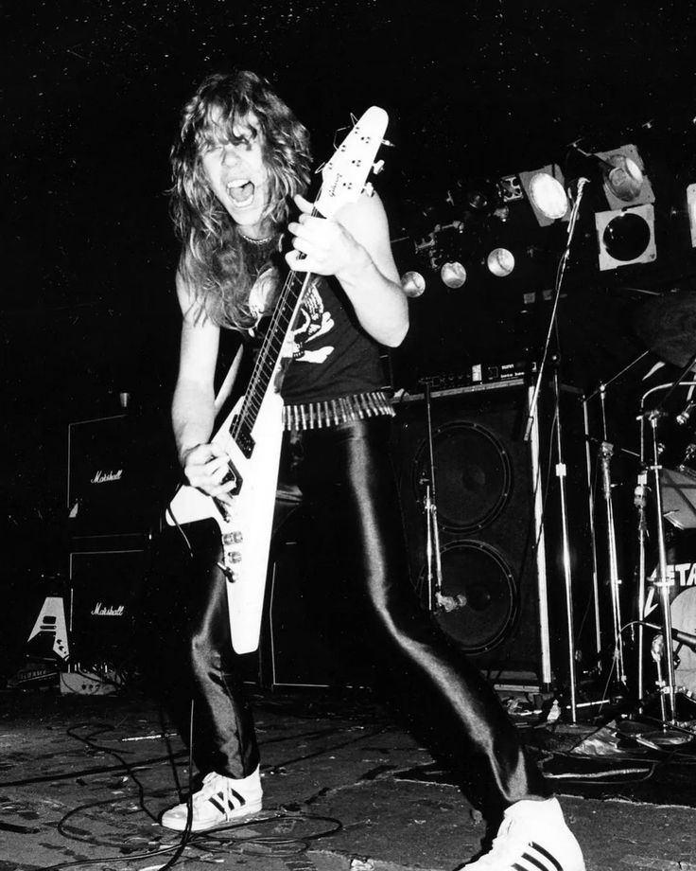

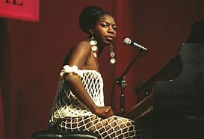

What is this research about?
This research focuses on dissecting pieces of music from different genres.
Even though the genre is different, the meaning is still conveyed.
Notes:
So, what is this research about?
This research will explain how different songs, in different genres, convey an important message to the listener.
Whether the piece is punk, metal, pop, or even jazz, artists have a way of conveying meaning through: Melody, Tonality, Instrumentation, Rhythm, and structure

Slide 3
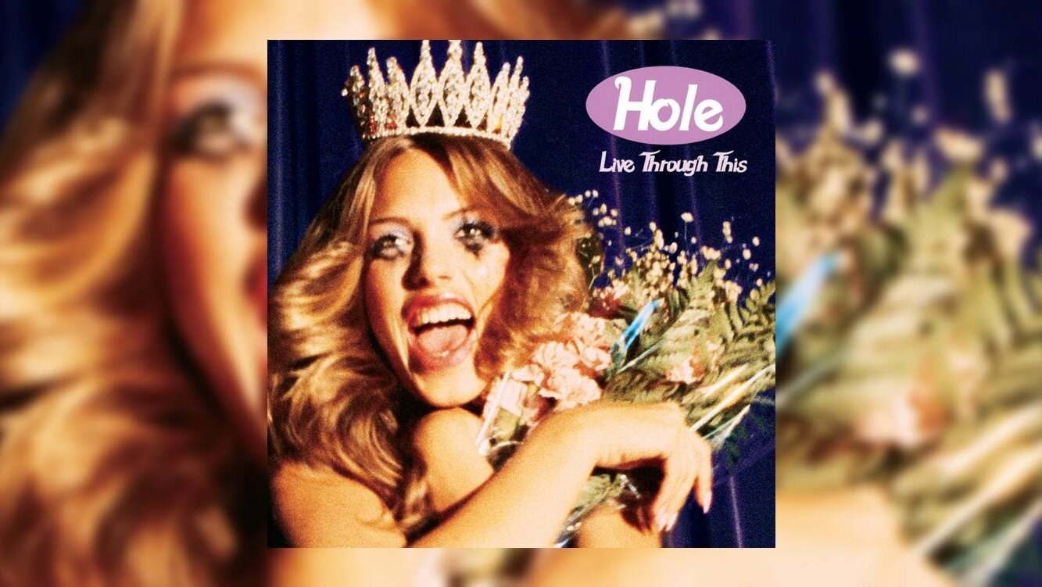

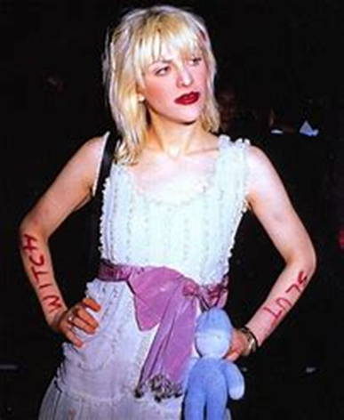
Asking for it - Hole
Before getting into the song, lets talk about the Historical impact and success of cause
Hole as a band are very well known by many grunge/punk fans. This is one of the many songs on the album Live through this that touches on topics of inequality between sexes and abuse whether it be physical or mental.
Notes:
The first piece I would like to talk about is Asking for it by Hole from their album Live through this.
Hole are an American alternative rock band, known mainly by their frontwoman Courtney Love.
She is known for her unique fashion sense.

Slide 4

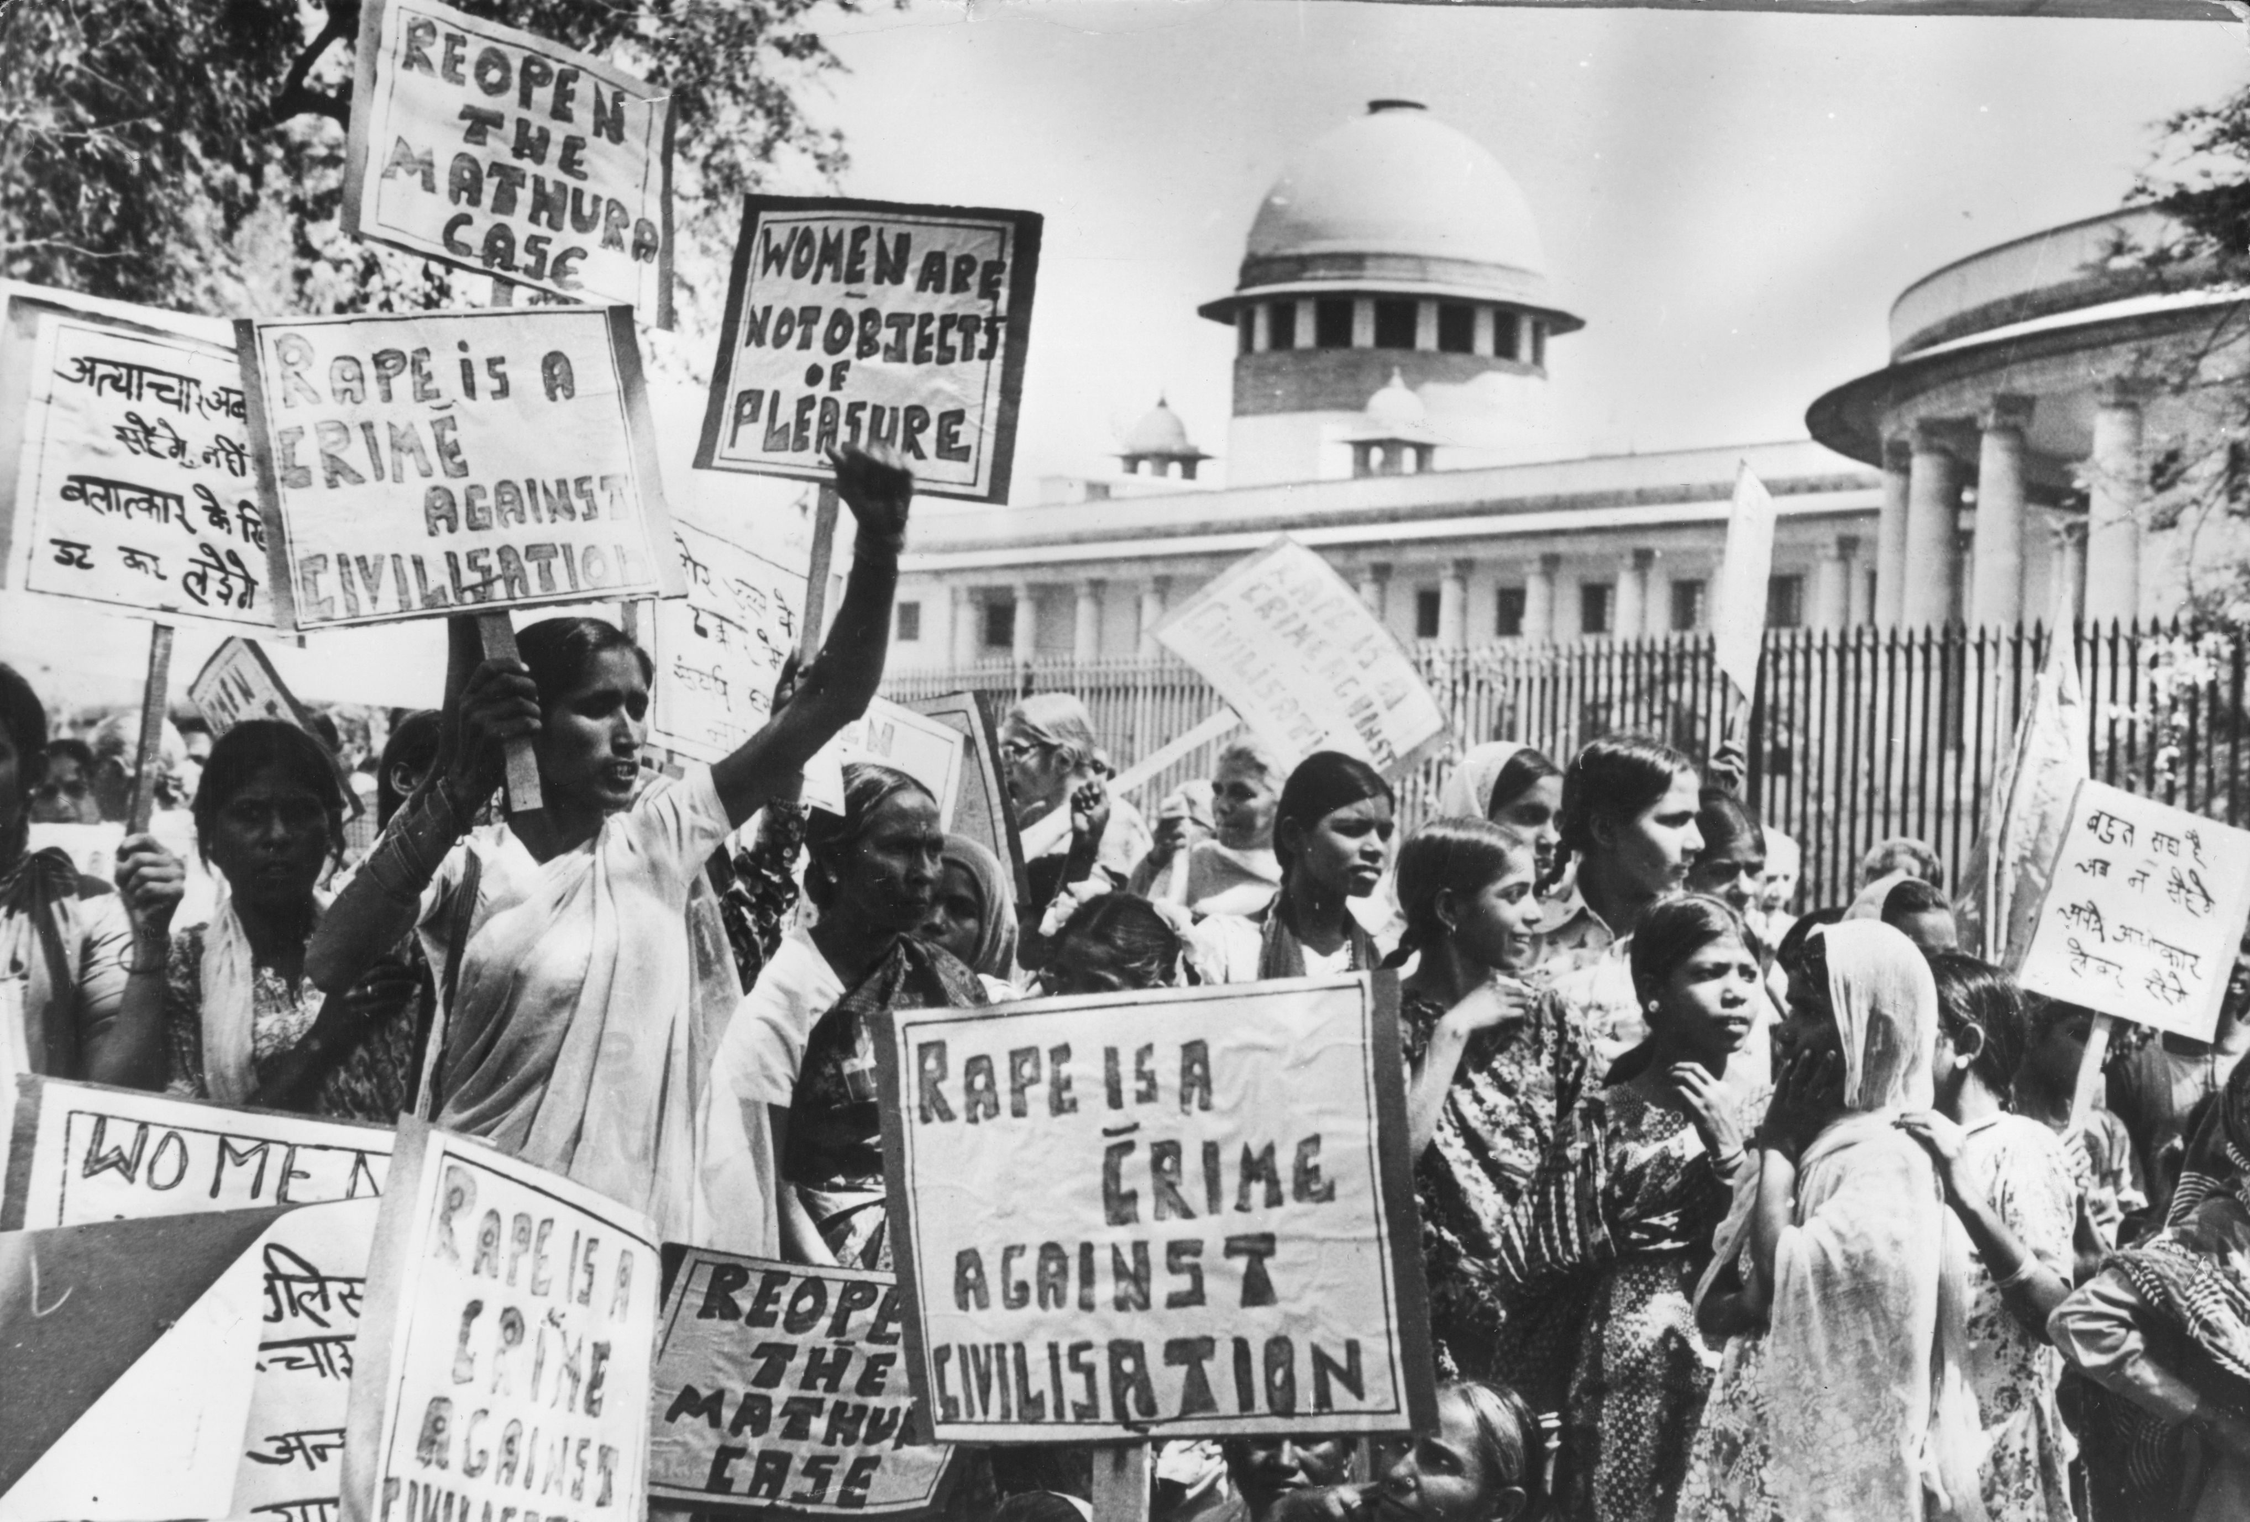

Time to dissect!
The lyrics in this song talk about harsh topics such as rape and the sexualisation of women in the media.
The verses and choruses at the beginning sound soft and clean toned. Perhaps to represent innocence.
The song is in a major key! ☺
This is called juxtaposition.
Towards the end of the song, the guitars become distorted and the vocals harsher.
This sounds angry and agressive.
Notes:
Firstly, lets talk about the melody of the song
In the first verse the lyric “I will tear the petals off of you” seem to be talking about forcefully removing items of clothing from a woman. The word “petals” is used to imply something delicate and easy to tear, this could be referencing the stereotype of women being weak and delicate
The chorus repeats the phrase “was she asking for it” referring to something commonly said to victims of rape or assault by people who think wearing certain things and acting a certain way justifies the offense.
The song has a major tonality, this contradicts the dark and upsetting lyrics. This is called juxtaposition, artists do this to sometimes to emphasise their point.
The vocalist, Courtney Love, had an experience in which she did a stage dive in a dress and was assaulted by an entire crowd.

Slide 5
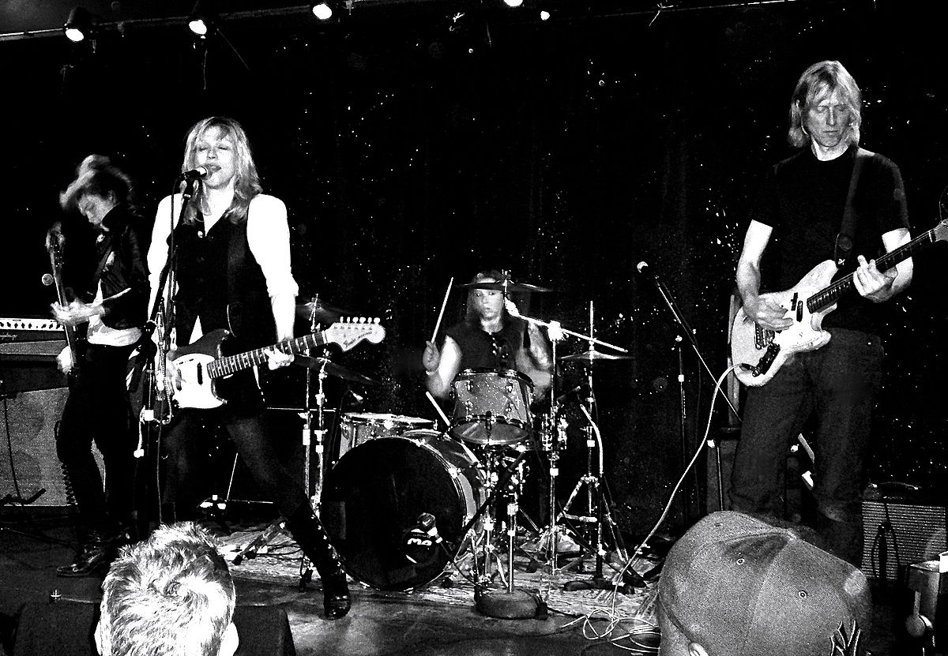
This song uses a classic rock band set up!
Lead Guitar – switches between clean and distorted
Rhythm Guitar
Drums
Bass Guitar
Vocals – express emotion clearly.
The song is also in 4/4
This could signify things never changing and staying the same!
Pop song structure
ABABCBD
Notes:
This song uses a rock band set up
This includes lead guitar, rhythm, drums, bass and vocals. The voals express the anger felt in the song as well as the desperation. The guitars switch from clean toned to distorted in certain parts of the song The Song is in 4/4 which could possibly signify a lack of change in society.
It uses a classic pop structure with verses, choruses a bridge and an outro.

Slide 6
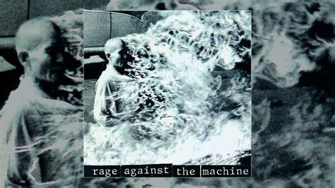


Killing in the name – Rage Against The Machine
This song talks about islamophobia, hatred against minorities and police brutality.
As the song gets heavier so does the meaning.
This song ended up in the top end of the charts near Christmas time in the US and UK, this showed that the songs meaning is relevant always.
Notes:
The lyrics talk about islamophobia and hatred against minorities. The melody fluctuates between sounding soft and getting heavier as does the meaning.

Slide 7
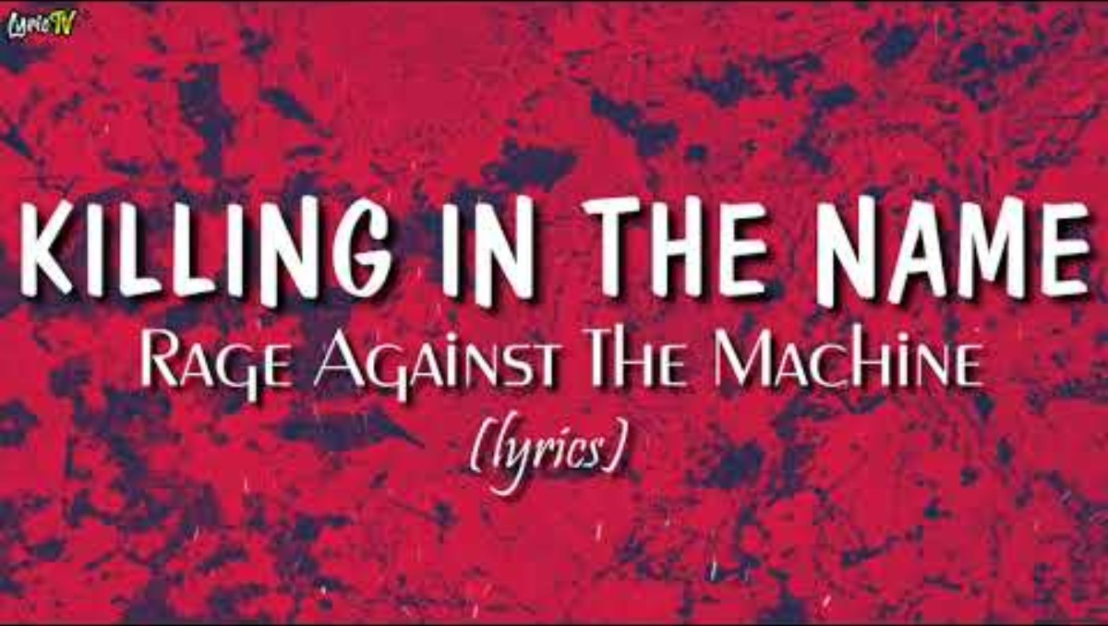
This song is in a minor key. ☹
This reflects the angry/ upsetting nature of the song.
There is also NO CHORD PROGRESSION in this song.
4/4
Things always stay the same!
The structure is :
ABCBC
The lyrical parts of the song start quietly, as the song goes on they become more aggressive and get louder.

Slide 8
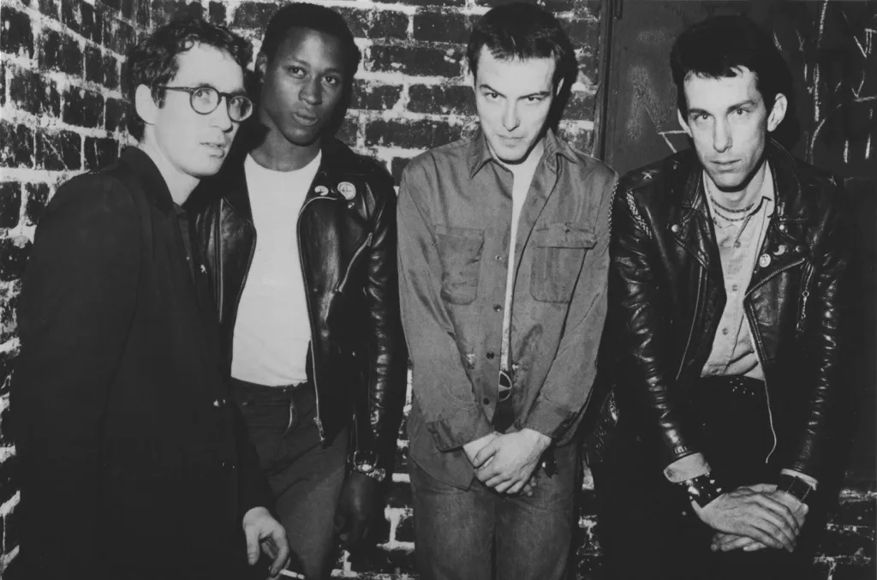
Police truck – Dead Kennedys
Historical impact and success of cause
It references an incident that happened in the 70s in Oakland, when some police officers were drinking on the job and taking advantage of being in a police truck on their shift.

Slide 9
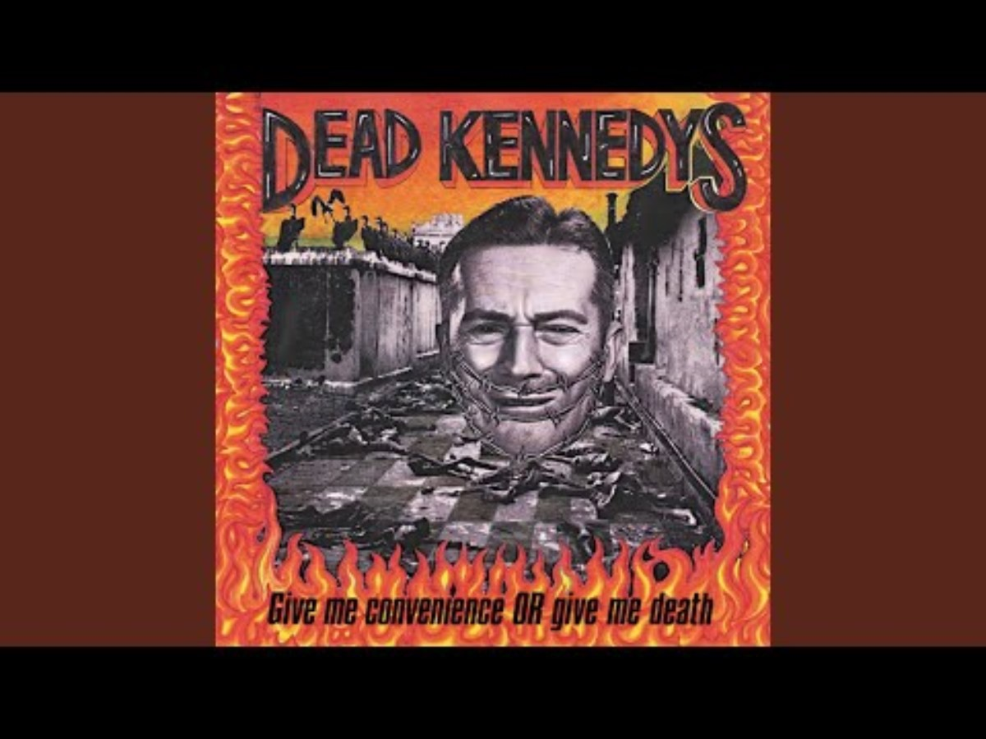
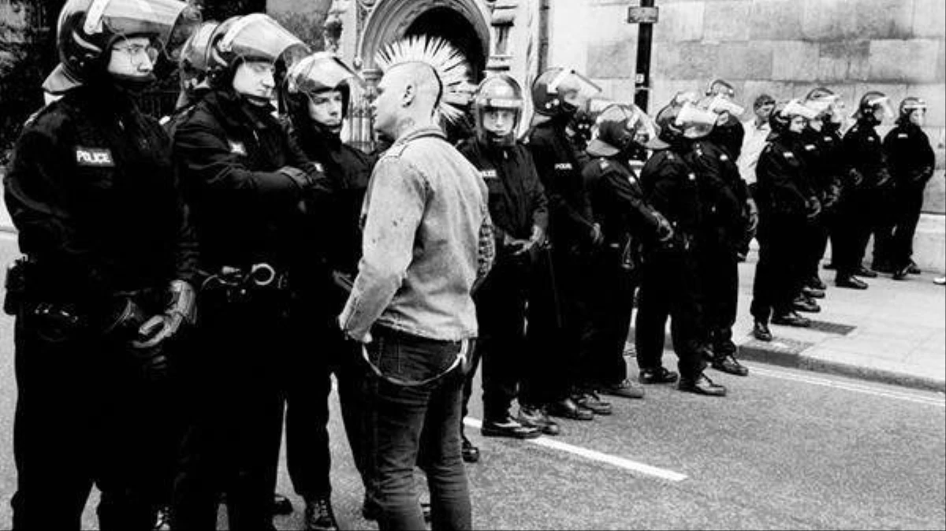
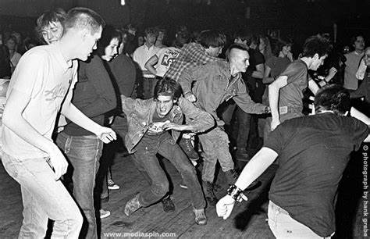
The lyrics talk about police brutality and police officers abusing their power.
The song is major!
ABAB structure so that the song can be used in riots!
Typical rock band set up with lots of distortion.
Notes:
The lyrics are about some police officers drinking on the job, gang raping sex workers, abusing drunk people and getting away with it because they think the law doesn’t apply to them. It is major to imply the joy the officers feel while getting away with such brutal acts and abusing their power as men of the law. It has a typical rock band set up of guitar, bass, drums and vocals. As it is a punk song they use a lot of distortion and effects on the instruments. it has a simple verse chorus structure in order to make sure people remember the lyrics as punks usually attend riots and such.

