Slide 1
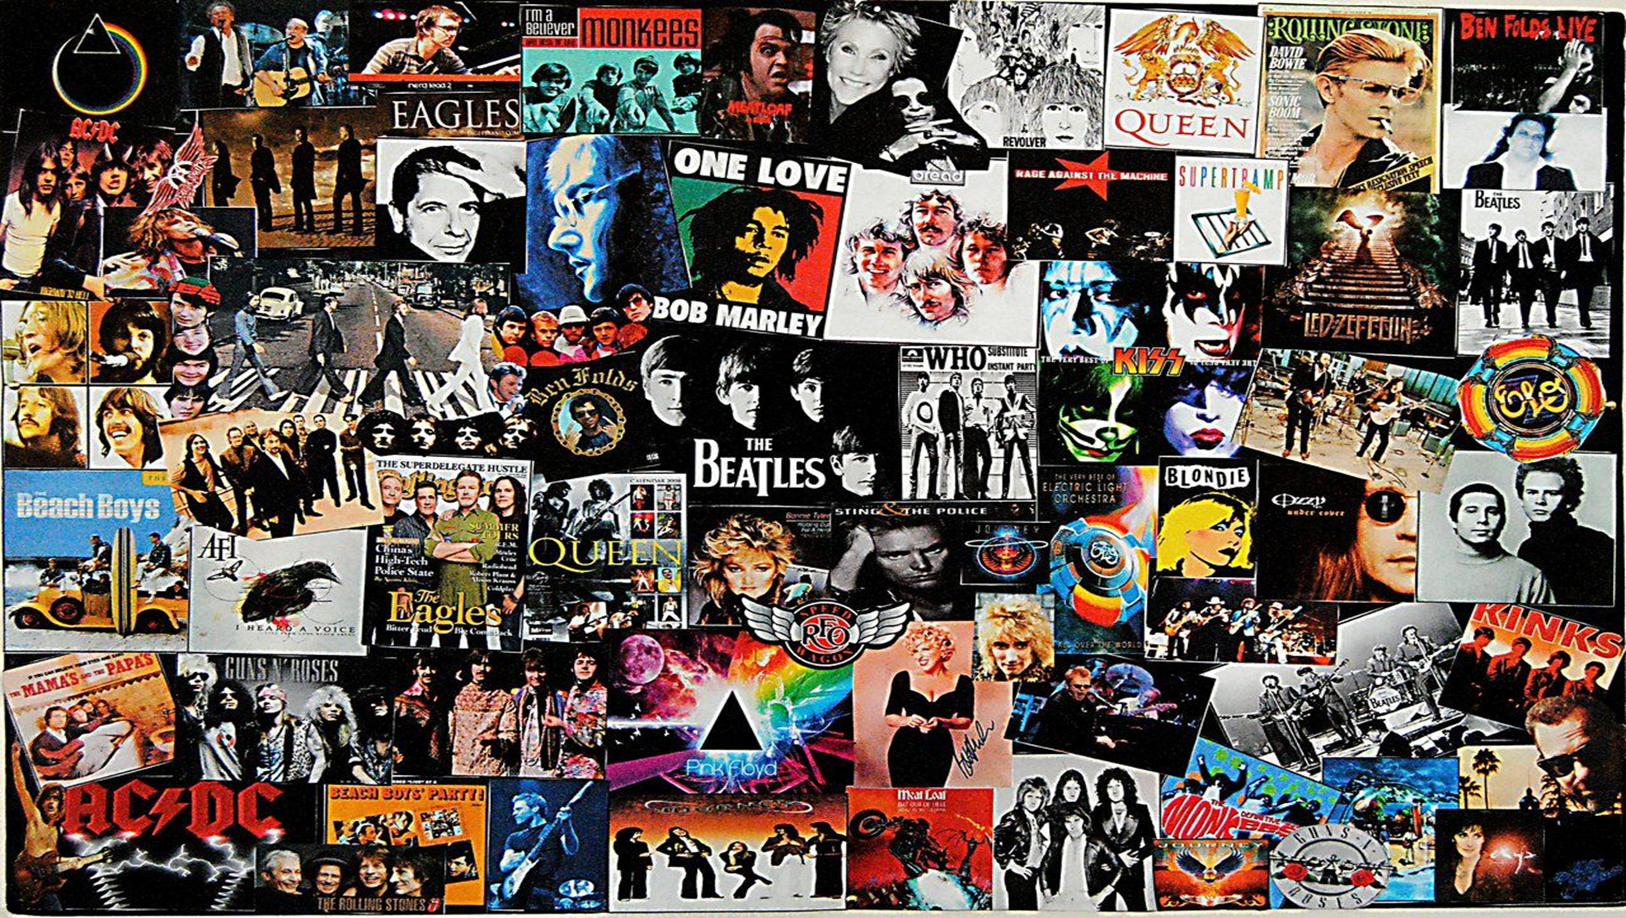
Job Role Research
By Mia Bainbridge

Slide 2

What does a manager do?
In the music business, having a manager is essential. In terms of managing a band, this job role needs to organise and approve of pretty much anything the band/ artist does.
A manager approves of any gigs, promotion and releases an artist makes.
Notes:
This job role requires working alongside a massive team of people, all with different jobs. Some examples are : Roadies, Sound Technicians, Media management, Finances, Stage Constructions crews, Fashion/ makeup artists and more.

Slide 3
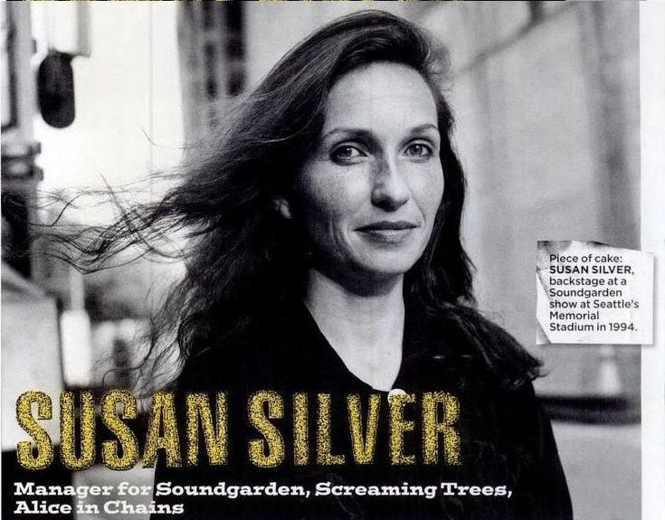
Susan Silver
Susan Silver is a band manager who has never had much recognition, although she deserves lots.
She was a staple in Grunge history and the Seattle rock scene.
“Susan Silver is the most powerful figure in local rock management.” – The Seattle Times, 1991
Notes:
Susan Silver made many decisions for these bands that very much contributed to their fame. She encouraged Nirvana to sign a deal with Sub Pop Records in 1990, this then led to the release of their album Nevermind.
, Managing bands such as the Screaming Trees, Soundgarden and Alice In Chains.

Slide 4
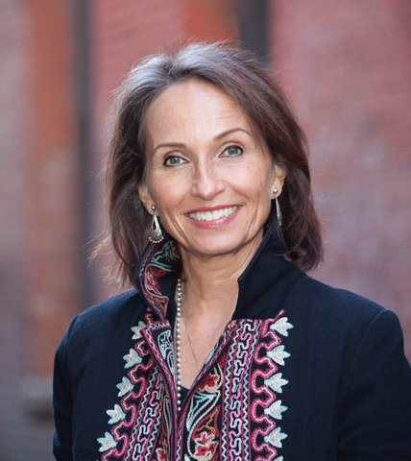
“The hardest part of being a manager is being helpless to other people's self-destruction.” – Susan Silver
In her Biography on IMDB, Susan mentions about being inspired by the creative process.
Notes:
Susan talks about how she enjoyed the creative process of music and even theatre. This proves very useful when being a manager because you know exactly what needs to be happening and I plan on doing the same thing. Using what I know to provide advice and strict tasks for bandmates.

Slide 5

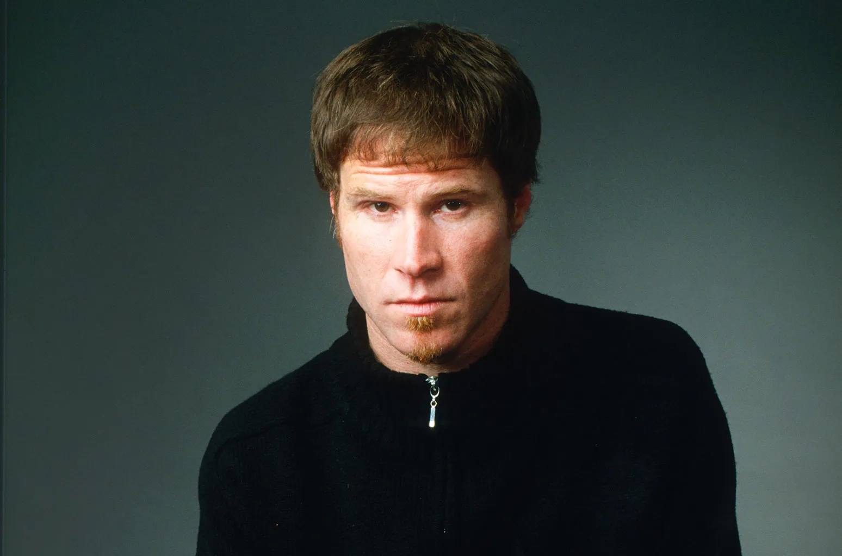
"There aren't many things I regret about my life, but of course not managing Nirvana was a mistake“ – Susan Silver 2022
Managed 1996 - 2005
Managed 1985 - 1998
Managed 1986 - 1998
Nirvana
Alice In chains
The Screaming Trees
Soundgarden

Slide 6



Hayley Williams

Slide 7


Who is Hayley Williams?
Lead singer of Paramore
Joined in 2004
“One of the only vocalists whose live belting matches the perfection of her voice on the record”
Paramore hayley williams interview with singing success - YouTube
Notes:
Hayley Williams is the lead singer of Paramore and is very well known for her powerful belt. She is historically one of the only vocalists whose live belt matches that of the recording.
Paramore started getting famous when Hayley Williams was around 16, this meant she had to learn how to safely sing their songs to prevent damaging her voice early in her career.

Slide 8


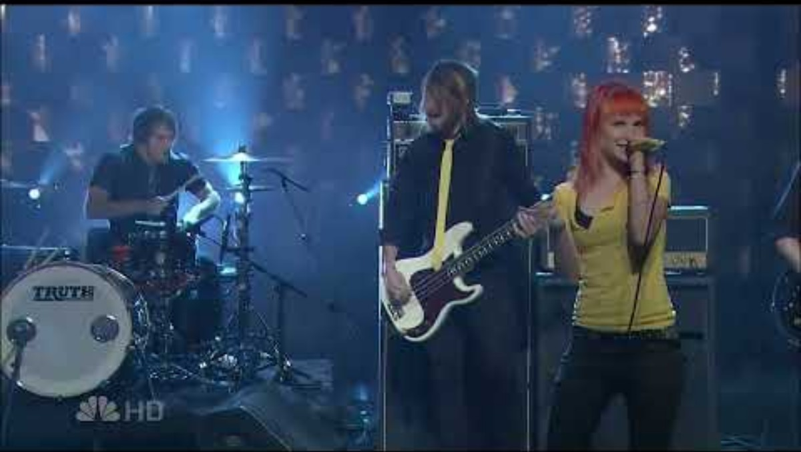

Paramore made music for the Twilight Saga.
She has a very powerful stage presence aside from her vocals.
Notes:
Paramore has been very successful throughout their time as a band. From touring with other major artists to creating music for the soundtrack in the Twilight Saga.
When Paramore perform on stage, Hayley lets her music speak for her and really conveys emotion through the way she moves and sings her songs.

Slide 9

How will I incorporate this into the performances?
Hayley's fashion and stage clothes.
Conveying strong emotions
Energy and Stamina
Notes:
Hayleys on stage clothes seem relatively comfortable and easy to move around in, this is something I am taking into consideration because her style is still alternative while being comfy at the same time.
The emotions conveyed through Hayley's stage presence come from really emphasizing the way a song makes her feel or the meaning behind it. I intend on doing something very similar in order to make a performance more visually interesting.
The energy and stamina she has during performances is very important. In an interview with SELF magazine Hayley mentions how she doesn't eat dairy, eats breakfast every morning and drinks herbal tea. She also mentions her performance being a crazy work out but still warming up the morning of a show by doing some exercises, this is something I want to incorporate to retain health while doing performances.

Slide 10




Thanks for listening XD

