Slide 1

Out Of Fashion
Project proposal

Slide 2

Lights…

Slide 3
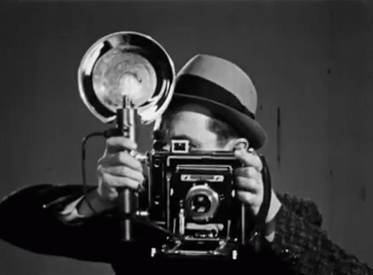
Camera…

Slide 4
ACTION !

Slide 5


Slide 6
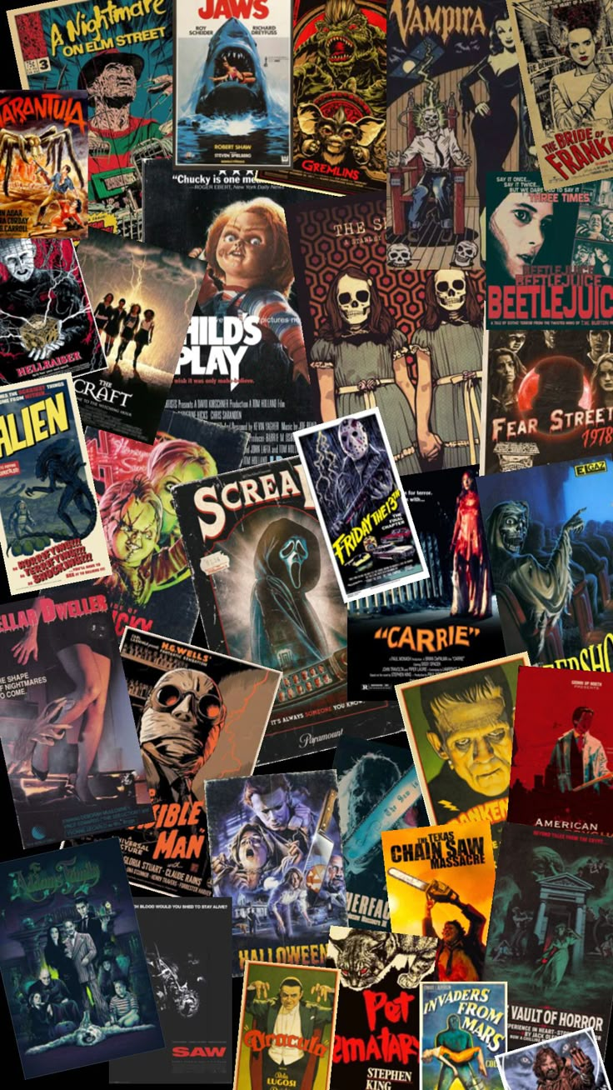
Movie Night

Slide 7

Why the theme "Movie night" ?
We enjoyed learning and performing a variety of genres during the course.
Theme chosen : Movies
Shared strength in teamwork, which made preparing for performances enjoyable.
Team's diverse music tastes and goals: some focus on creativity (stage presence, songwriting), others on technical aspects (sound engineering, music theory).
Agreed on song choices that include all instruments and suit everyone in the band.

Slide 8





Immigrant Song
Immigrant Song by Led Zeppelin was the first track on their 1970 album Led Zeppelin III and released as a single.
It’s a popular song with several live performances and renditions by various artists
Written during the summer of 1970 while touring Iceland, Bath, and Germany.
Robert Plant drew inspiration from his travels to the Nordic region of Iceland, known for its cold temperatures and snow, which is referenced in the song's chorus.

Slide 9
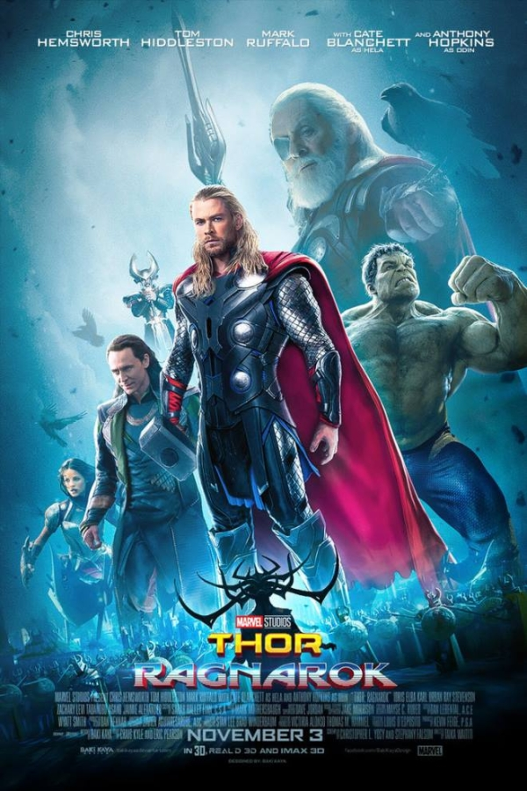
How does immigrant song link to our theme ?
Immigrant Song appears in Thor: Ragnarök.
It plays twice: first in the opening action scene (Thor vs. Surtur) and again in the final battle on the rainbow bridge.
The song's use highlights its significance to Thor’s character, with lyrics like "the hammer of the gods will drive our ships to new land," linking to Thor’s iconic hammer.

Slide 10

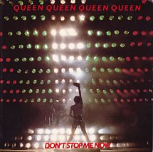
Don’t Stop Me Now
Released as part of Queen's 1978 album Jazz
Released in 1979 as a single
Recorded when the band were "getting better at having a good time"
Only became very popular after its use in films
Successful years later, partially due to being used in Shaun of the Dead in 2004
More guitar focused arrangement was used in the Biopic Bohemian Rhapsody

Slide 11
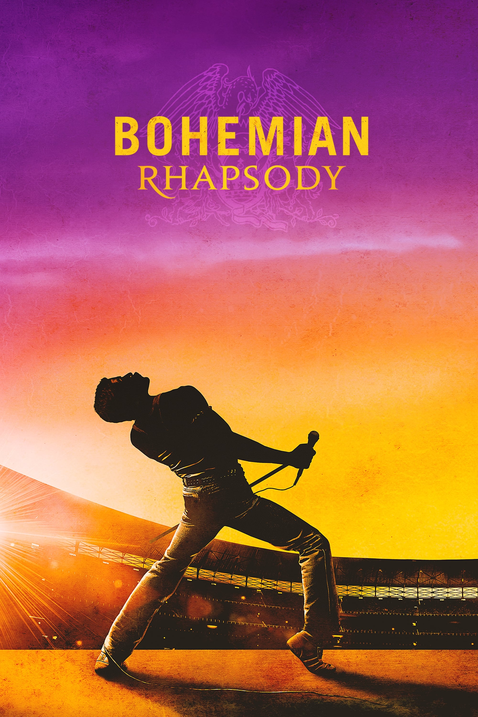
How does ‘don’t stop me now’ link to our theme?
"Don’t Stop Me Now" is featured in the Queen biopic Bohemian Rhapsody, highlighting the band’s journey to success.
The song plays at the end of the movie, after their Live Aid performance.
During the outro, pictures are shown of Freddie's life after the band, including his marriage to Jim.
The outro also shows how Jim partnered with Queen to start a charity in Freddie's honor.

Slide 12

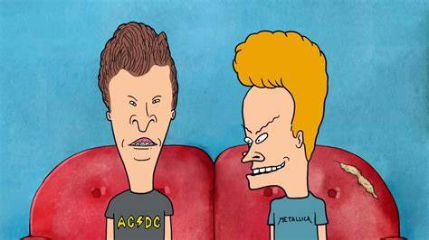
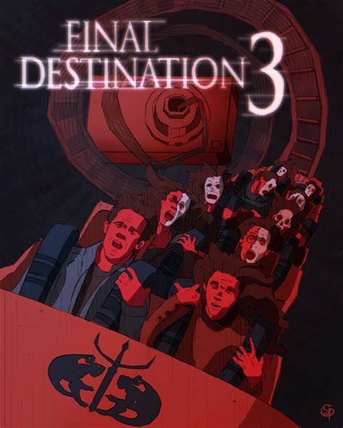
.
Love Rollercoaster – Ohio players
"Love Rollercoaster" from Honey was released in 1975.
Full song: 4m 50s, single version: 2m 52s.
Theme: Sudden highs & lows in relationships.
Featured in Final Destination 3 (2006) & Beavis and Butt-Head Do America (1996).
Beavis and Butt-Head Do America: Plays during the Casino Live band scene (gambling highs & lows).
Final Destination 3: Plays during the sunbed scene, foreshadowing deaths after a rollercoaster accident.
.

Slide 13

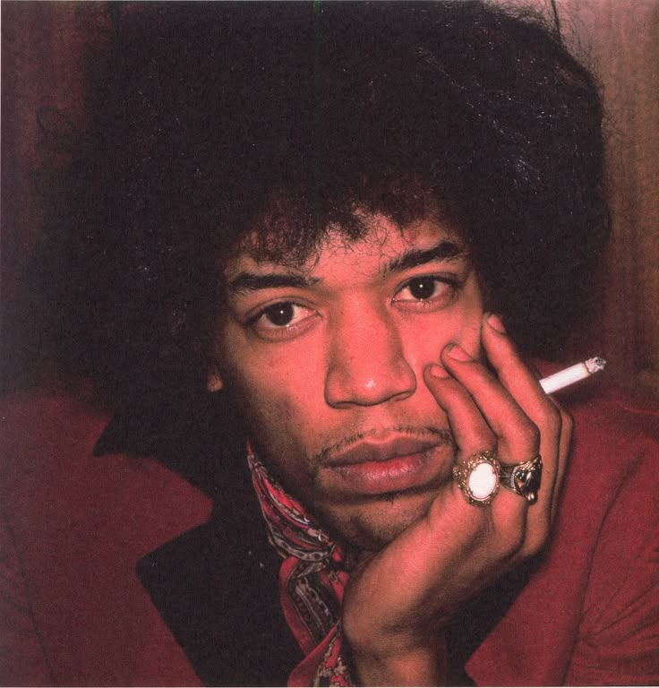
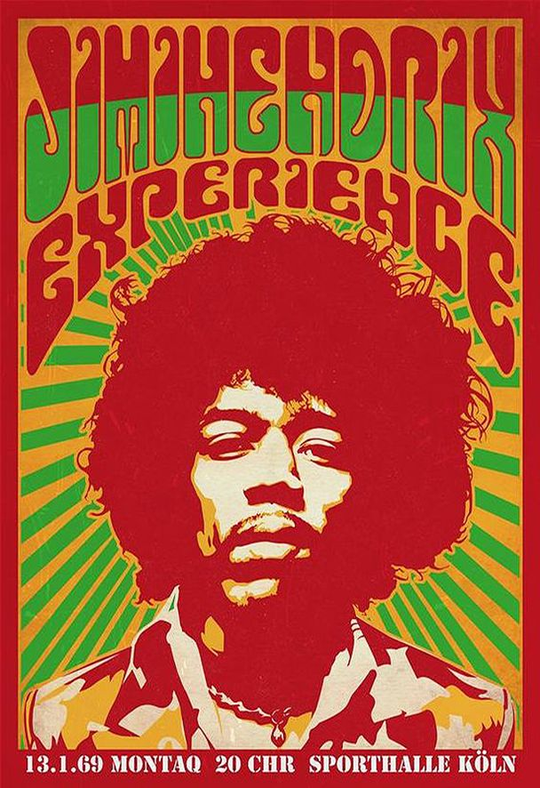
All Along The Watchtower - Jimi Hendrix
"All Along the Watchtower" was written by Bob Dylan in 1967 and covered by Jimi Hendrix in 1968 on Electric Ladyland.
Dylan wrote the song in 1966 after a motorcycle accident.
Themes: Social change & existential confusion.
Hendrix's version became the most famous rendition, praised for its electric guitar work and haunting atmosphere.

Slide 14
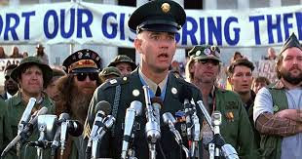
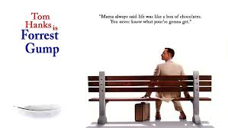
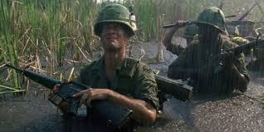
How does All Along The Watchtower link to our theme?
"All Along the Watchtower" is featured in Forrest Gump (1994).
The song used is Hendrix’s psychedelic cover of Bob Dylan’s song.
Used in the scene where Forrest arrives in Vietnam to fight, it plays after the Vietnam base welcome speech.
Relevant to the film’s 1960s–70s setting, aligning with Hendrix’s era.

Slide 15
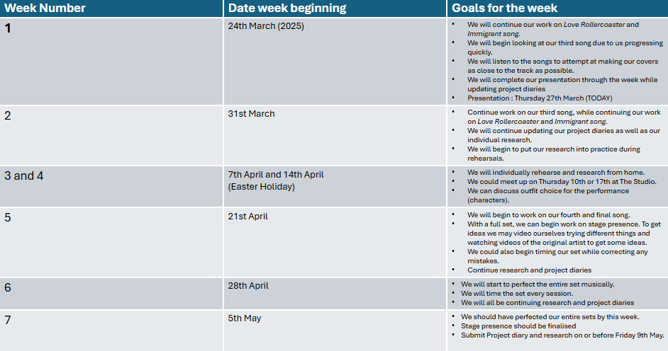

Slide 16
Evidence
During our rehearsals we will record our rehearsals by using videos and voice recordings to show how much progress we make during the weeks. These videos can be used as evidence in the bandmembers’ project diary to help show our improvements in each day of the week. They can also be used for the personal logs to show what skills they learnt from their personal research.
The reason for the videos being split into voice recordings and camera videos is because:
We will use the voice recordings for rehearsals where we improved the sound. For example, we might have changed the tone of an instrument to replicate the sound of a song as before we might have not known of beforehand.
We will use video recordings to show the changes we made in stage presence. An example of this is when we are at The Studio and the vocalists and instrumentalists have learnt a new dance from one of the sessions. The reason we record at The Studio is due to it having a stage for us to dance on.

Slide 17
Evaluation
When it comes to the end of the week, we will finish the week by saying what problems we faced as a group and how we solved each problem. This can be problems such as playing the wrong parts to having faulty equipment such as amps with broken valves and drums with a snapped snare wire.
Each bandmember will reflect on what we have learnt that week and how we can use that new skill to help improve their rehearsals. One example of this is the vocalists being able to put distortion on their voices for one of the songs, they will then talk about how they benefit from this new skill.
Finally, we will end with targets that we will have achieved by next week. These targets will be used to paint the picture for the bandmates have a focus on next week, this can range from the group's performance to their stage performance while playing.

Slide 18
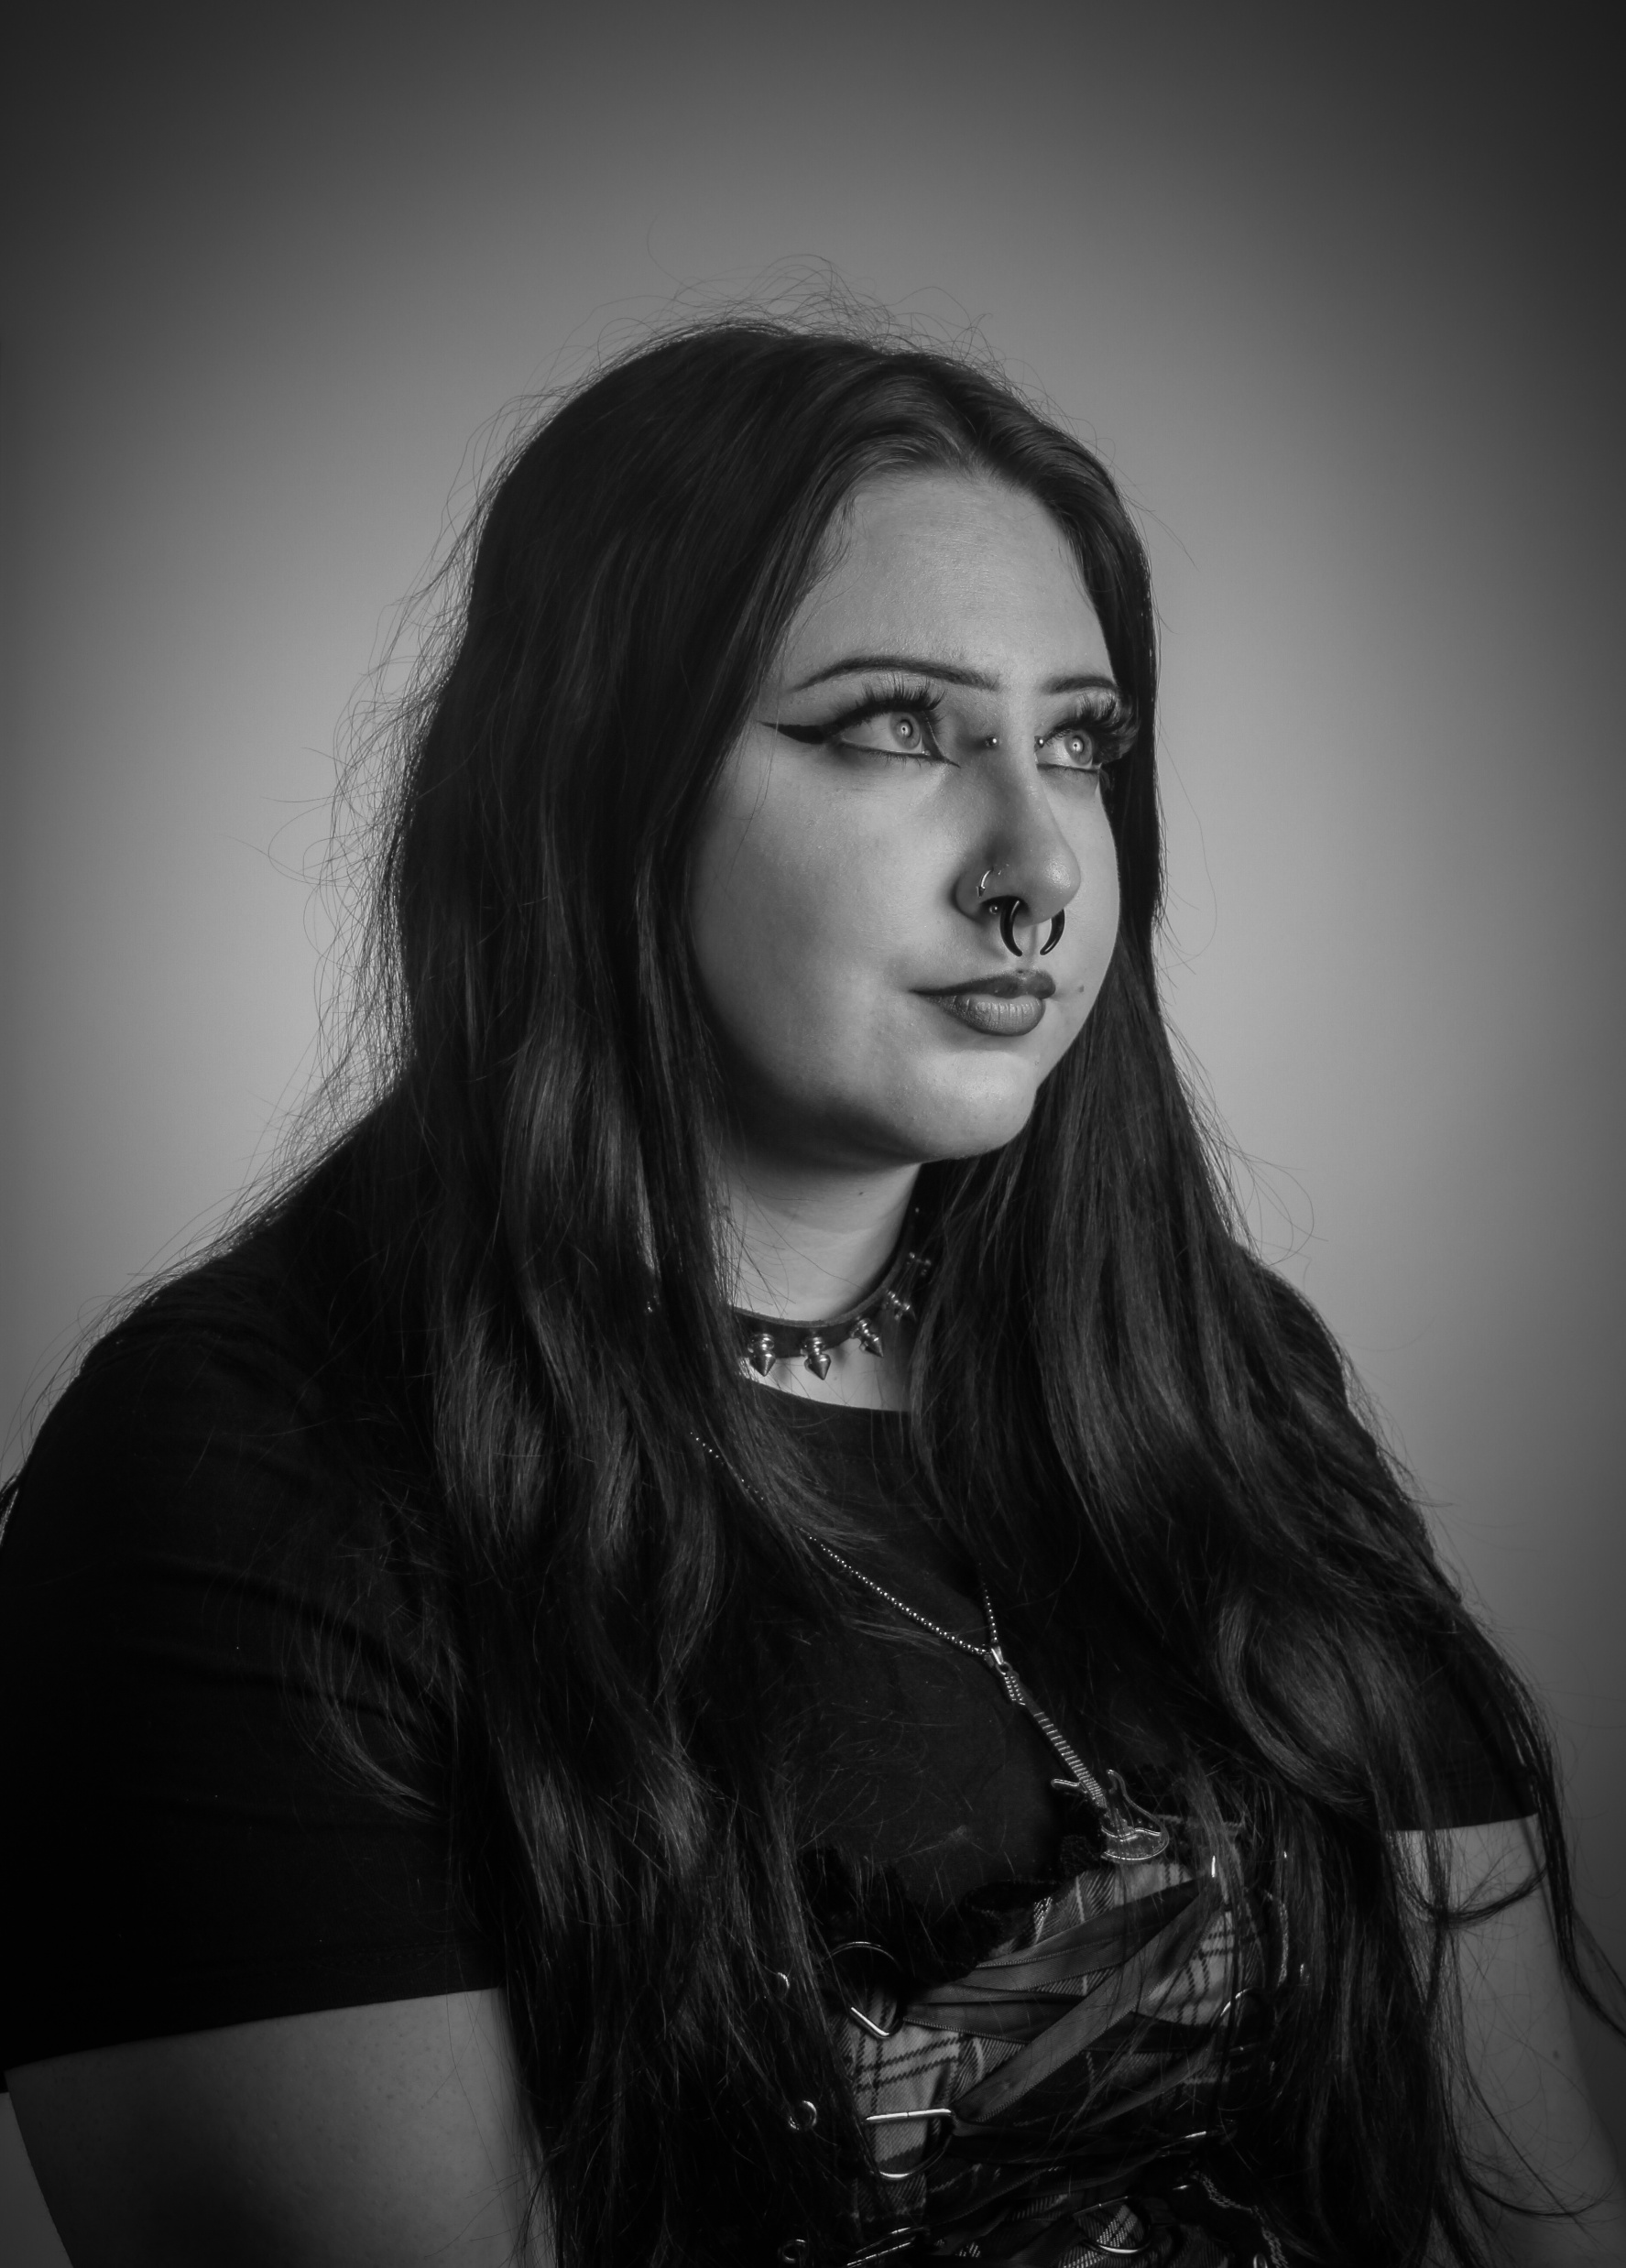

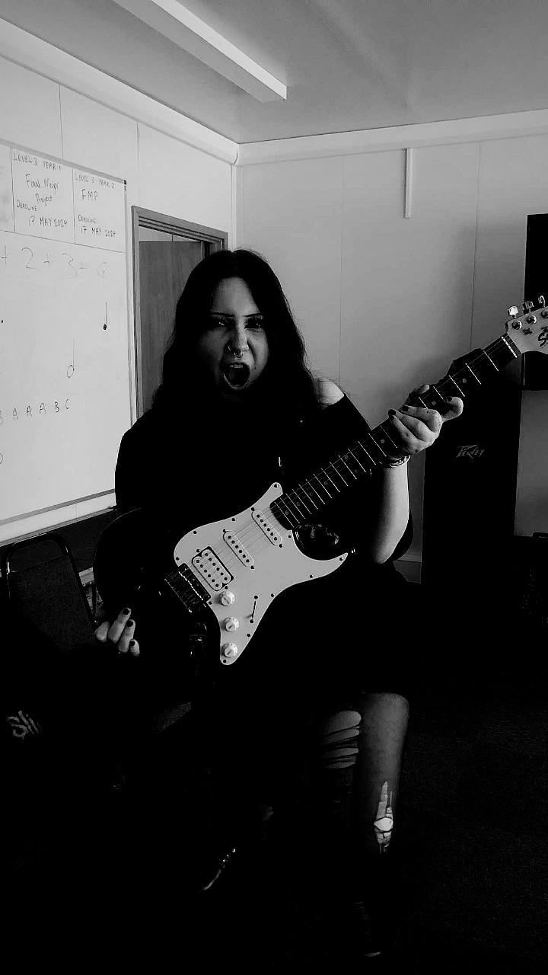

Mia’s Project Proposal.
Personal Project Focus: Exploring how different artists use personas/characters on stage and why.
Stage Presence Development: Focused on improving stage presence and creativity in choreography throughout the course.
Experimentation: Tried different looks and stage presence styles in previous terms to create entertaining performances.
Term Goal: Use research to define and possibly create a personal stage persona.
Influence from Performers: Inspired by various performers studied throughout the year for stage presence ideas.
Project Plan: Intends to develop and implement a unique stage persona through the personal project.

Slide 19
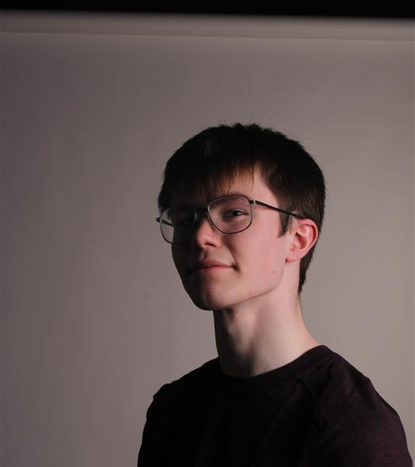
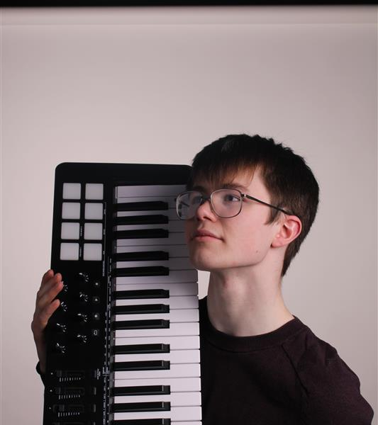
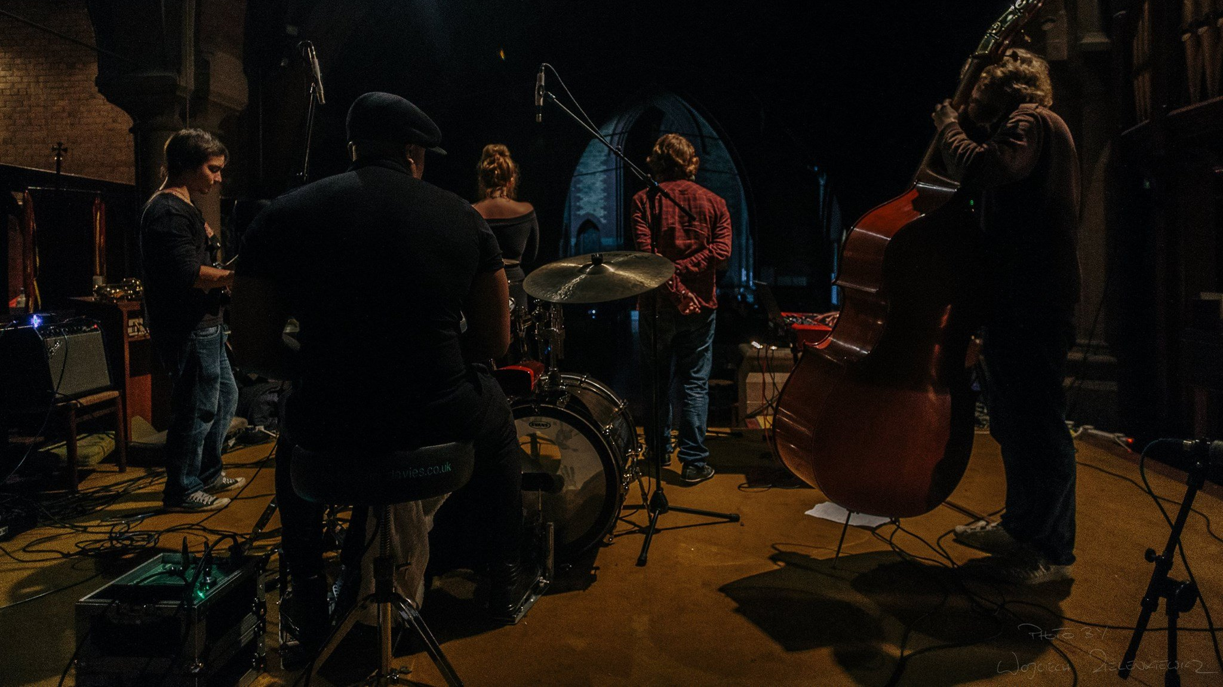
Alex's Project Proposal
Personal Project Focus: Improvising in a more melodic and rhythmically interesting manner.
Improvisational Development: Studying techniques to become a more varied and creative improviser.
Experimentation: Continuously apply improvisation techniques and exercises learned from more experienced improvisers.
Term Goal: Being able to apply these techniques to improvise more creatively in melodic and accompanying roles.
Influence from Performers: Inspired by influential jazz pianists and educators.
Project plan: To research techniques employed by successful musical improvisers to improve my improvisational skills in the context of a band.

Slide 20

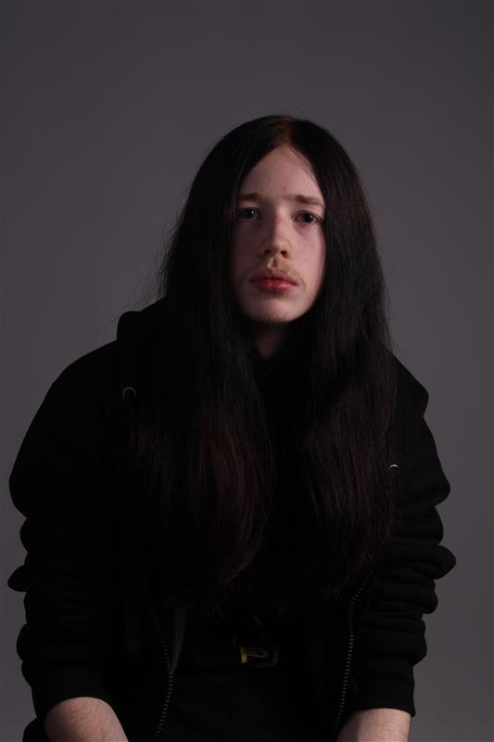
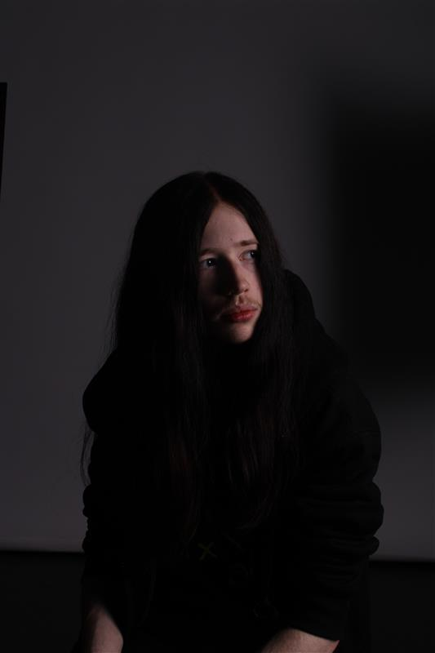
Lukes project proposal
Personal project focus: Exploring and incorporating new techniques in music, including slapping, popping, tapping, slides, hammer-ons, muting, and ghost notes.
Reason for interest: These techniques are unfamiliar to me as I haven’t used them in previous terms, and I believe learning them will help me expand my musical skillset.
Skills development: By practicing techniques outside my usual repertoire, I aim to challenge myself and enhance my overall musicianship.
Influential musicians: Inspired by Flea (Red Hot Chili Peppers), Cliff Burton (Metallica), and Justin Chancellor (Tool), who all used these techniques to develop distinctive sounds and styles that helped propel their bands to fame.

Slide 21

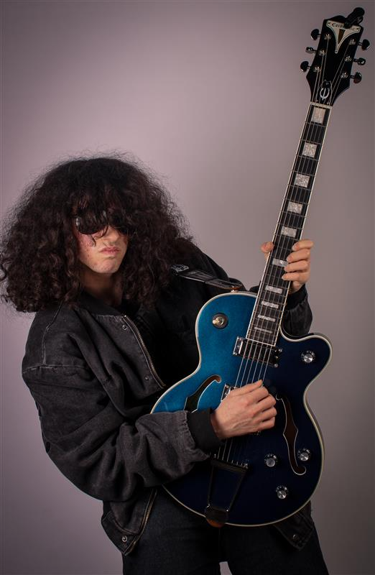
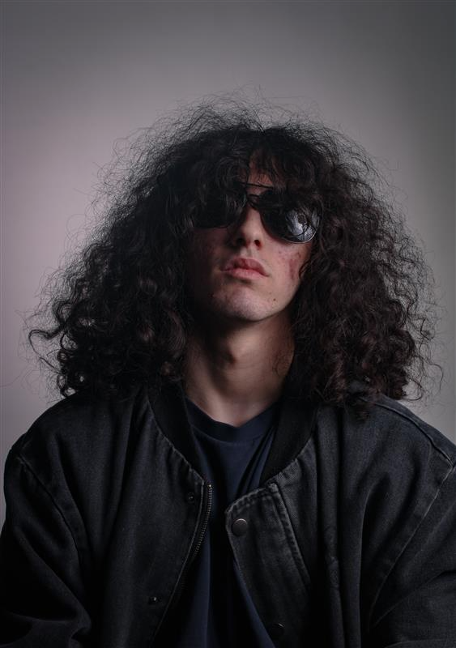
Gabriel's Project Proposal
Personal Project Focus: developing improvisation on guitar and how different famous guitarists improvised guitar.
Improvisation Development: Focused on improving my knowledge on theory and my use of scales throughout the course.
Experimentation: practising using theory to make my own parts in songs from playing chords in the same key to making my own solos on the songs.
Term Goal: Use research to be able to make my own parts that fit the style of the songs that our band will be doing.
Influence from Performers: Inspired by various guitarists, for example guitarists such as Jimmy Page, Carlos Santana and improvisation ideas.
Project Plan: Being able to use various techniques through the personal project.

Slide 22

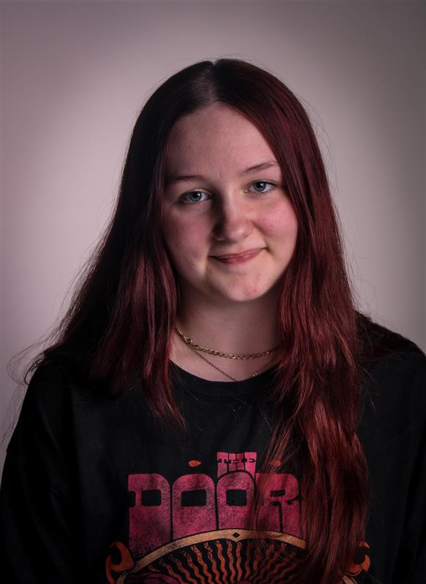
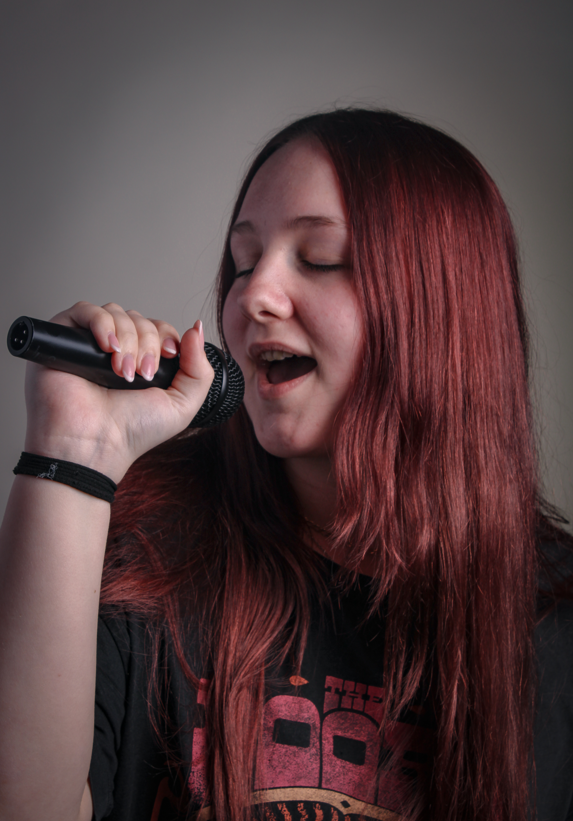
Eva-Rose's Project Proposal
Personal Project Focus- I am focusing on vocal harmonies and how different types of harmonies can affect different songs
Vocal Harmony development- Focused on making my own harmonies and seeing how different harmonies sound
Experimentation- trying different styles of harmonies and seeing what types work with different songs
Term Goal- use research to become better at improvising lower and higher harmonies
Project Plan- learn why using different harmonies changes a song and how to use the right ones where necessary

Slide 23

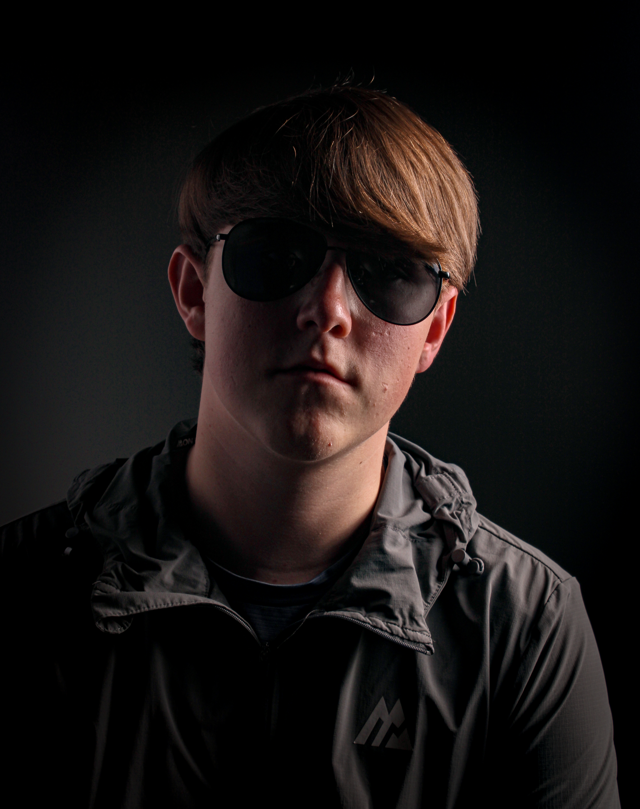
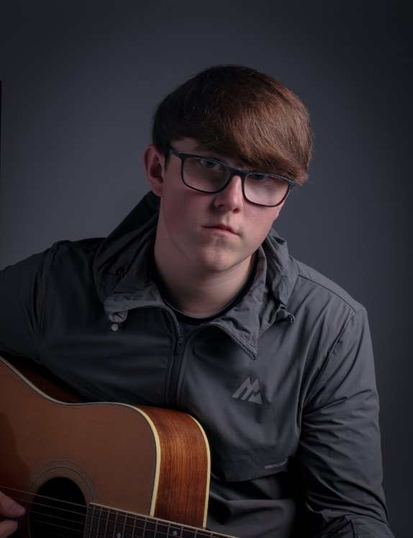
Ryan’s Personal Project
Personal Project: I am focusing on composition and how people wrote film music and making my own film music.
Composing a song: I will be composing and recording a song for a film of choice from a poll sent to my class.
Experimentation: experimenting with differently instruments and recording techniques that where used on other pieces used in films
Term Goal: to use this research to become a better song writer and producer for the future
Project Plan: Learn why things are recorded in certain ways and why they are produced in certain ways to achieve a specific sound

Slide 24
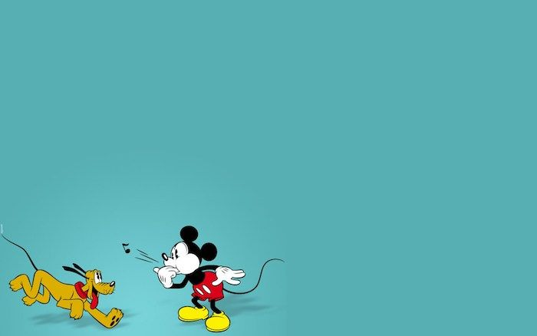
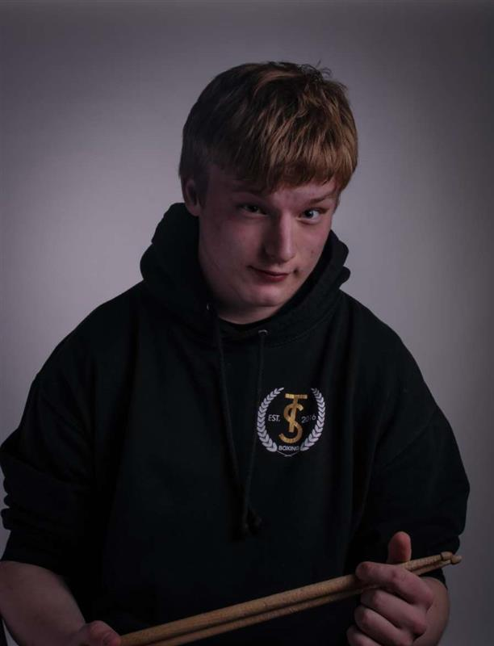
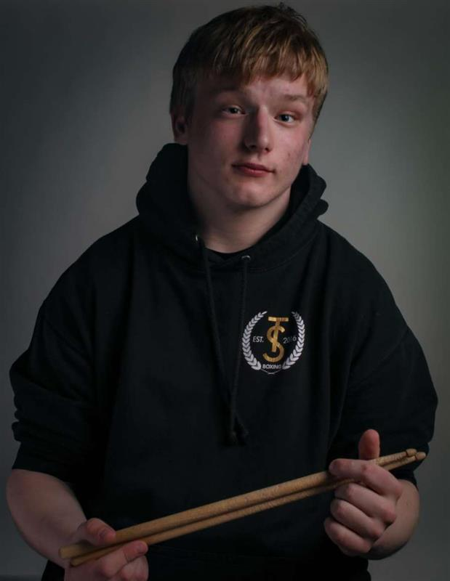
Harry’s personal Project
Term Goal
Learn effective effects combinations for different instruments.
Project Plan
Understand the purpose of effects and their impact on songs.
Experimentation
Test various effects during practice sessions.
Personal Project Focus
Explore effects for guitars and drums.
Tone Matching
Match guitar and bass tones to the original song.

