Slide 1

The art of on-stage personas
Researched by Mia Bainbridge

Slide 2
Why this project?
The reasons I decided to research this topic :
To explore why artists rely on these personas.
Gain an in depth understanding of stage presence through characters.
To get insight on how the characters are portrayed and why.
Understanding how and why these characters are created.
Notes:
Why have I chosen this project?
I have chosen this project because it feels specific to me as a musician and performer. I wanted to look at stage presence but something a bit more unique rather than just moving around because I already feel confident in this field. This research will help me discover why artists create personas, why they portray them in certain ways. I would also like to gain an in depth understanding of how stage presence can be affected by playing such a character. I feel as though this will help me as a performer.

Slide 3
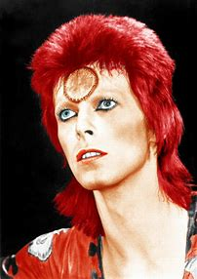
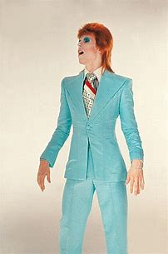
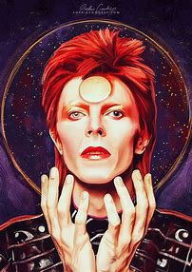
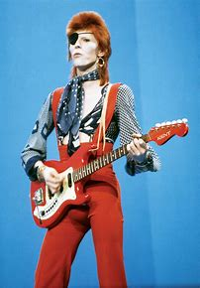
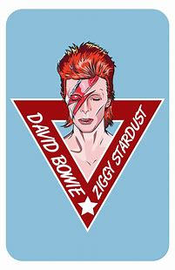
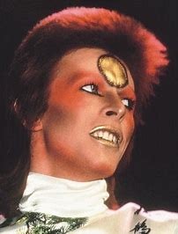
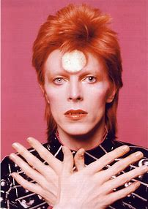
Ziggy Stardust

Slide 4
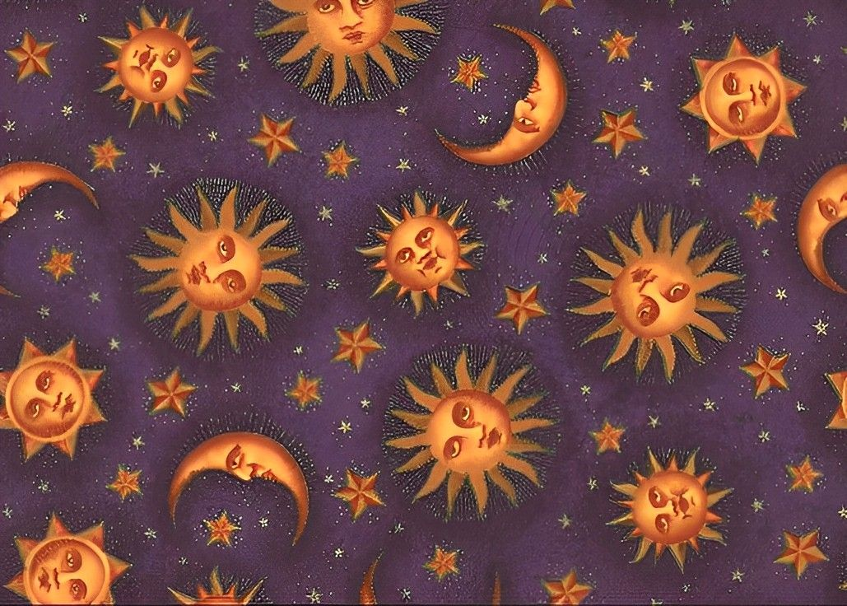
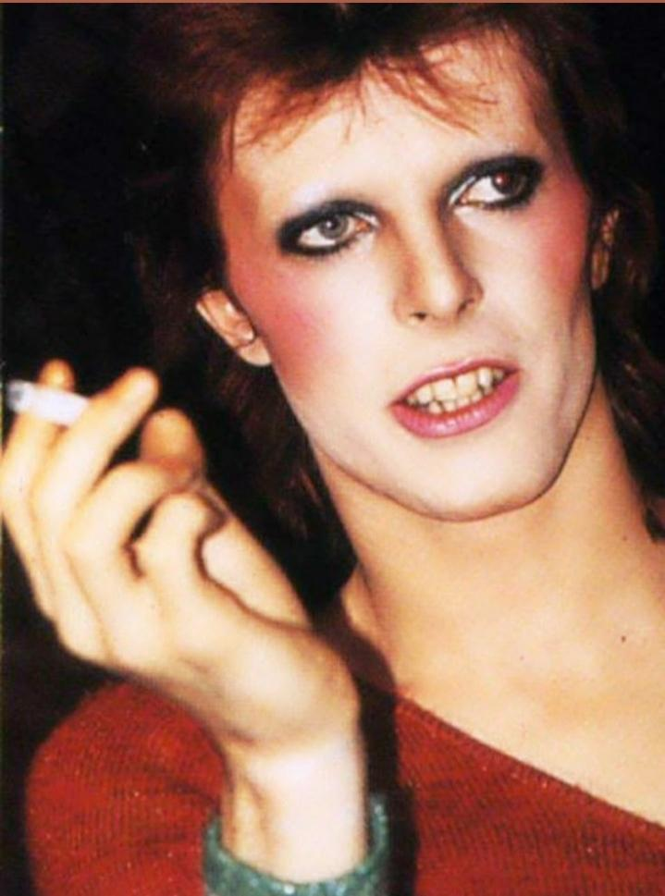

Who is Ziggy stardust ?
David Bowie's alter ego.
Made for the 1972 studio album : "The Rise and Fall of Ziggy Stardust and the Spiders from Mars."
An Androgynous, bisexual rock star from a different planet.
Notes:
So, Who is Ziggy Stardust? Ziggy was David Bowies alter ego, used for his studio album “the rise and fall of Ziggy Stardust and the spiders from mars”. The album was released in 1972 and Ziggy was actually created by Bowie’s management in order to challenge what society saw as taboo at that time. Ziggy was an androgynous bisexual rockstar from outer space. Men wearing makeup and conventionally feminine clothes was very uncommon in this era and some believed it to be “very unnatural”. The reason Bowie’s management did this was so that Ziggy could attract attention from society and media at the time because this meant more people might be curious as to what Bowie’s music was like therefore listening to the album.

Slide 5
Ziggy's Story.
An Androgynous, Bisexual rockstar from another planet.
Gives messages of hope and warning to the humans of earth.
He wastes his newfound fame.
Ultimately dies an untimely death at the end of the album.
Sent to earth before an apocalypse.
He is treated as a messiah and becomes famous.
Notes:
As stated, Ziggy was from another planet. The album essentially gives us a storyline of Ziggy’s life. He came to earth to warn humans of an apocalypse and offered words of hope. Society then welcomed him as a messiah for doing this because he was alien and came to help them. When Ziggy has attracted this newfound fame, he lives his life on earth in luxury with an overwhelming ego given to him by the humans of earth. He ultimately dies at the end of the album through ‘Rock n Roll suicide’ (he partied too much and it eventually killed him for wasting his fame and being selfish).

Slide 6
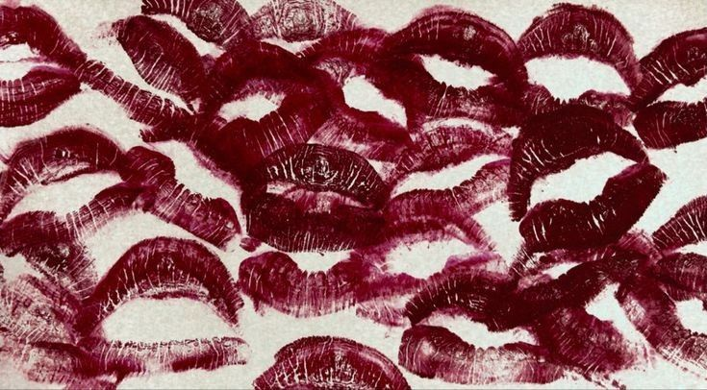
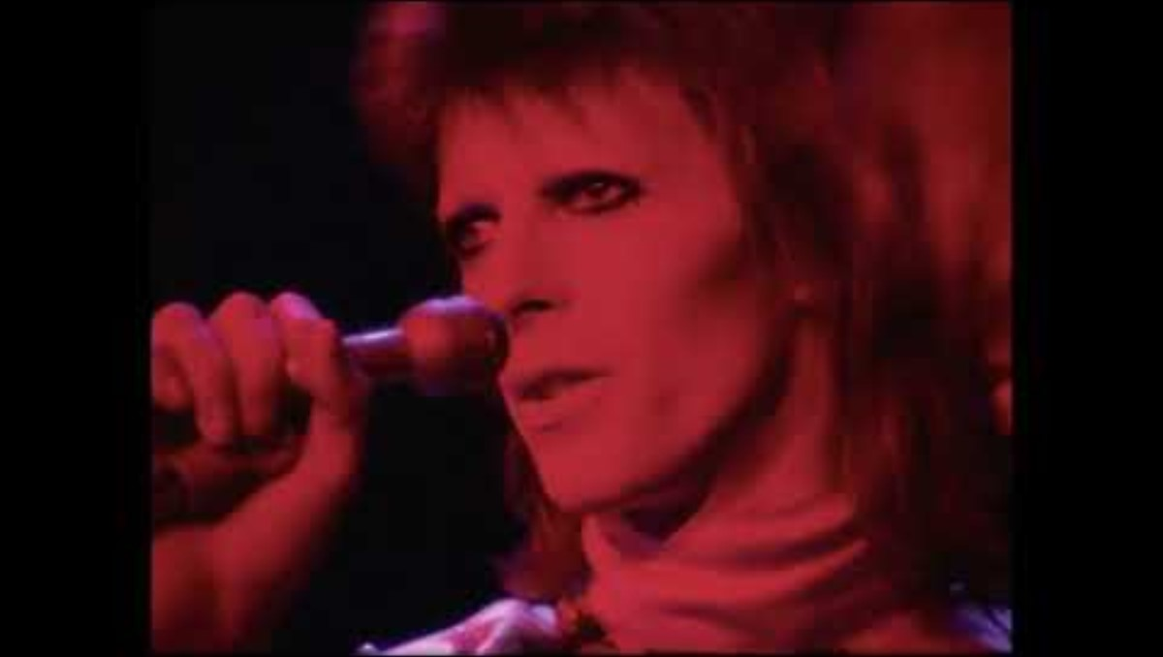

Slide 7

Stage Presence.
Lots of arm movements.
Use of Mic stand.
Eye contact.
Lots of confidence.
Interesting physical appearance.
Notes:
From the clip, we can see Bowie's use of arm movements and mic stand techniques. He is able to express the emotions behind the song through these dramatic arm movements. The use of the mic stand is interesting in this case because he does not move it much but enough to still be visibly entertaining. David Bowie's eye contact with the crowd show off his excessive confidence while putting on the character of Ziggy Stardust with his unique appearance.

Slide 8

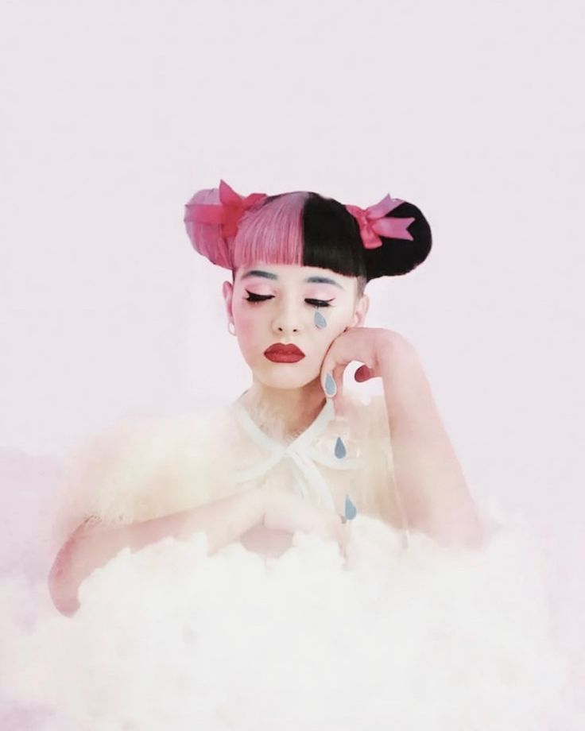

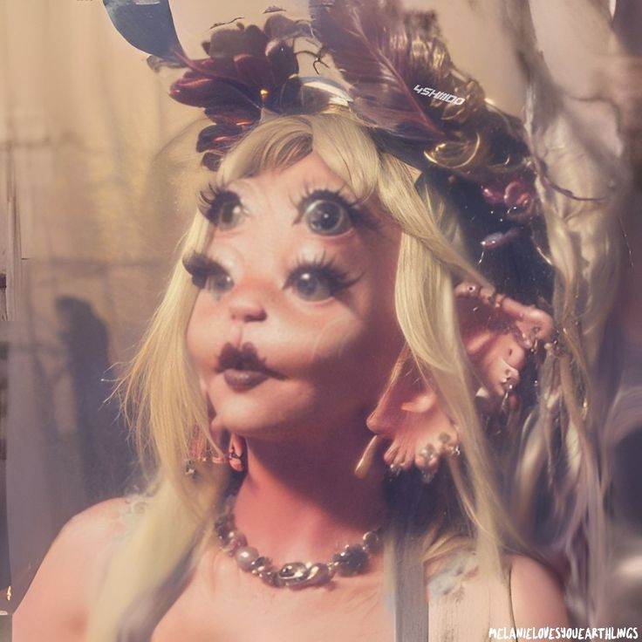
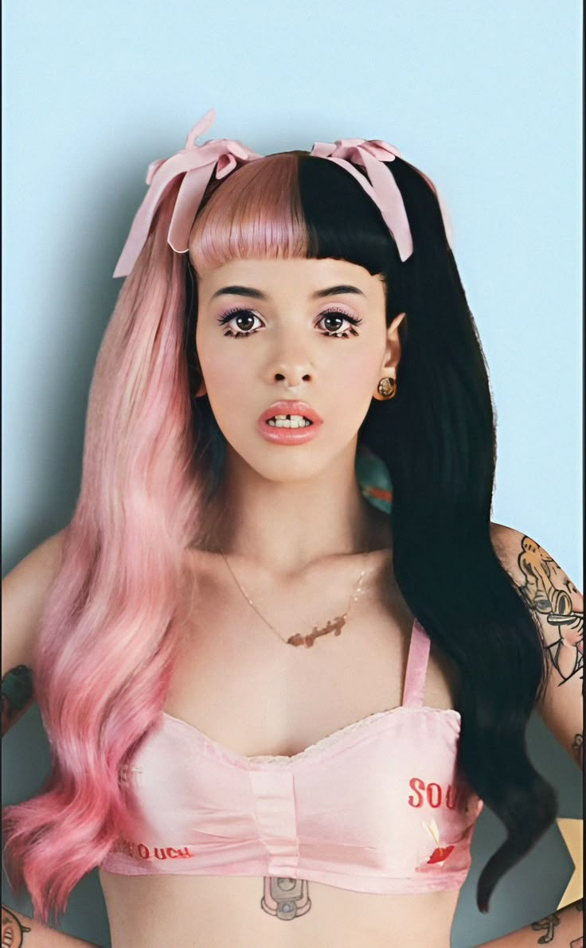
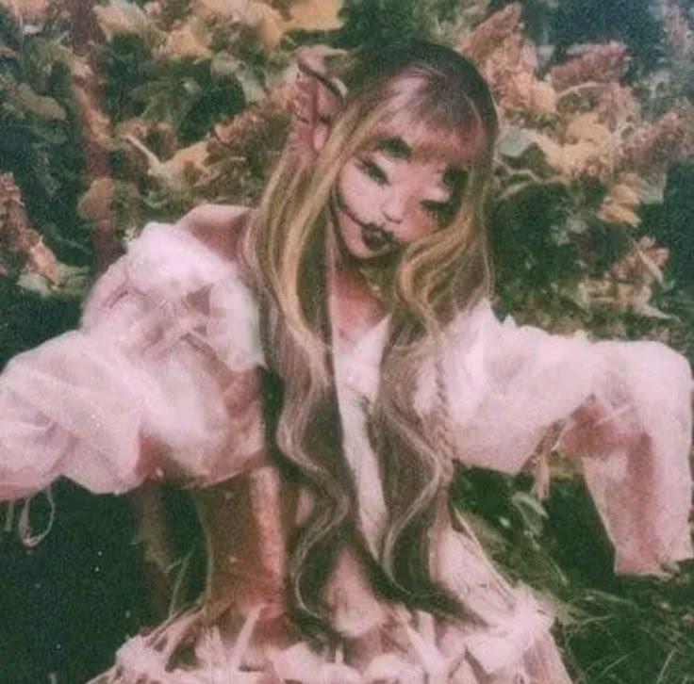
Melanie Martinez

Slide 9

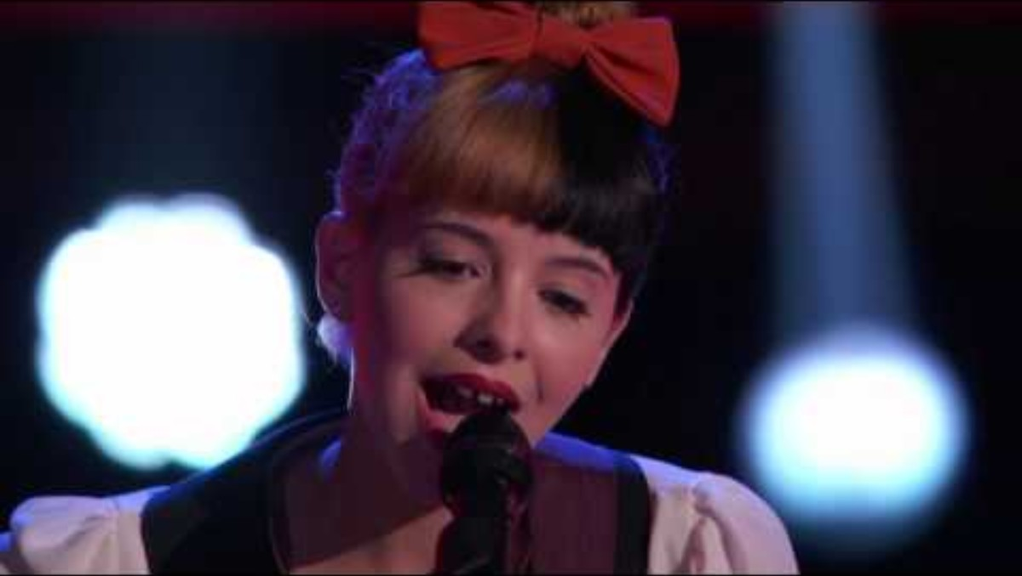
Who is Melanie Martinez?
Melanie Martinez is a Pop singer/ songwriter.
Also a director and photographer.
Born in Astoria, Queens (1995).
She was on ‘The Voice USA’
Unique doll – like appearance.
Has a character named Cry Baby in her first few albums.
Notes:
So, who is Melanie Martinez? Melanie Martinez is a pop singer/ songwriter as well as a director and photographer. She shoots a lot of her own music videos and directs them. She is from Astoria in queens and has Puerto Rican descent from her parents. She had wanted to be a singer from a young age being inspired by iconic popstars like Britney spears. In her audition for the voice in 2012 she sang her own version of Toxic by Brittney spears that perfectly displayed her creepy and cute aesthetic through her voice. This is when Melanie first began to gain popularity. In Melanie’s first few albums, she portrays the character of Cry Baby. Cry Baby is a child character who is used in her songs to talk about deeper situations such as : Abuse, relationships and even eating disorders. This character is more of a metaphor that Melanie uses when writing songs to convey these difficult topics in a less disturbing way, hence the creepy yet cute aesthetic.

Slide 10

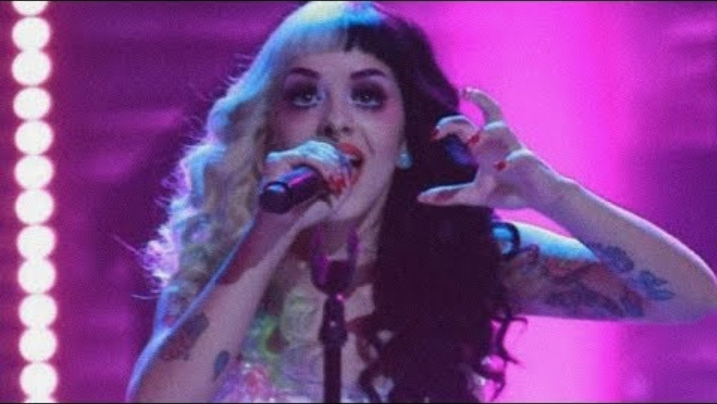

Slide 11

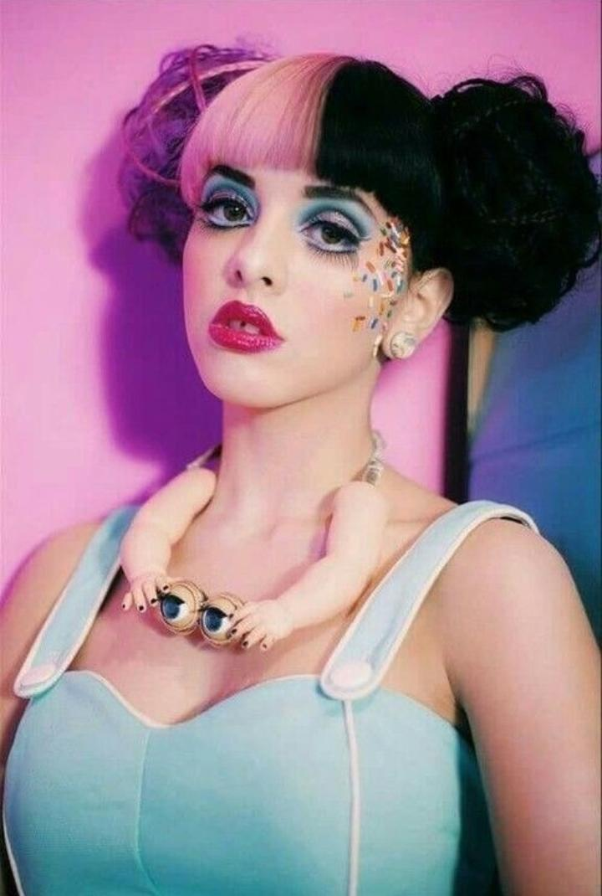
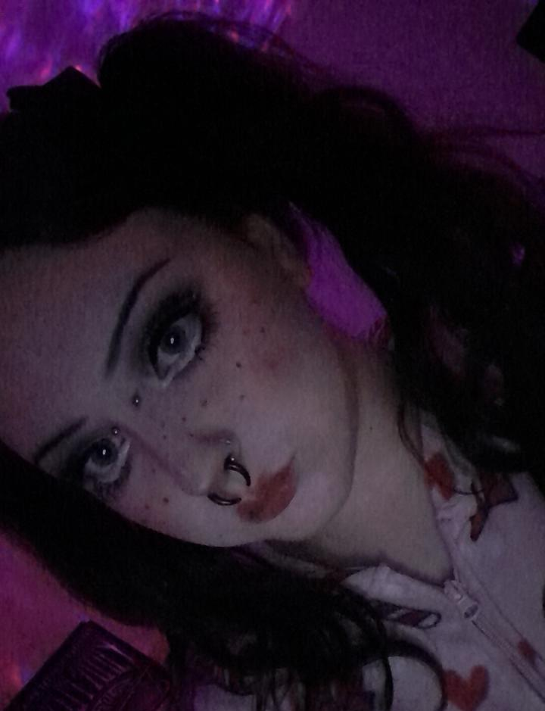
Stage Presence.
Dances around to the music.
Creepy doll – like makeup.
Costume change.
Only uses mic stand when necessary.
Notes:
Something notable about then way Melanie Martinez performs is her movements. She seems to dance in any way that she feels because she lets the music control the way her body moves. Despite her Cry Baby character being an infant, Melanie does not act this was on stage she does the opposite. Her costumes and makeup may resemble some kind of child like toy but the themes of her songs are much heavier than they seem. The costume change seen in this video seems to almost free Melanie's movements as she begins to dance and show more emotion afterwards. She also only uses her mic stand when it is necessary such as getting out of the first costume. Otherwise, she dances around the entire stage especially in instrumental sections of her songs.

Slide 12
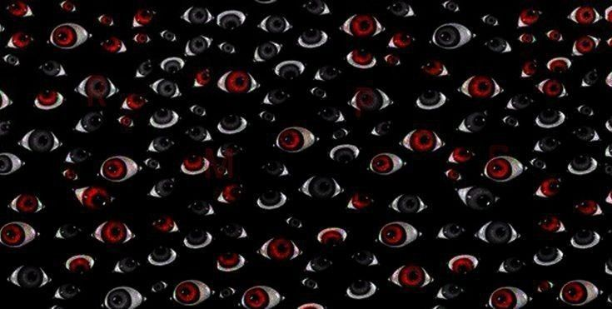
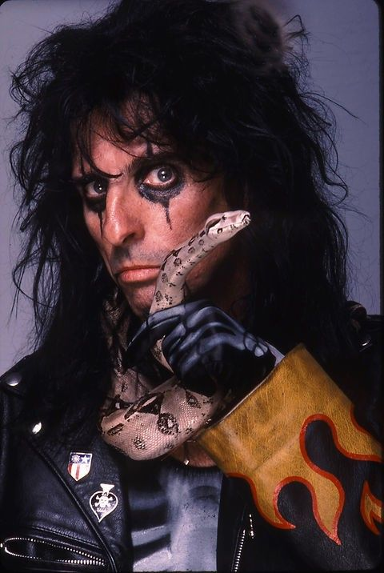
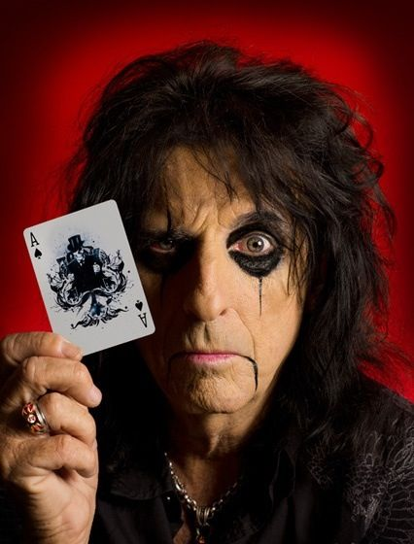
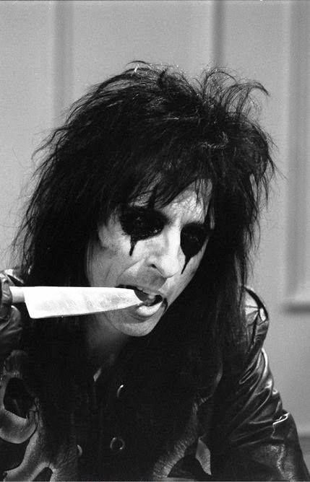
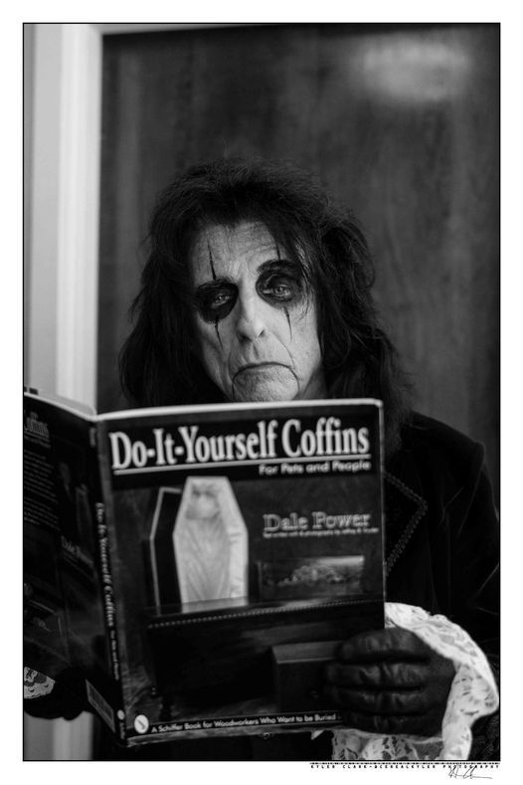
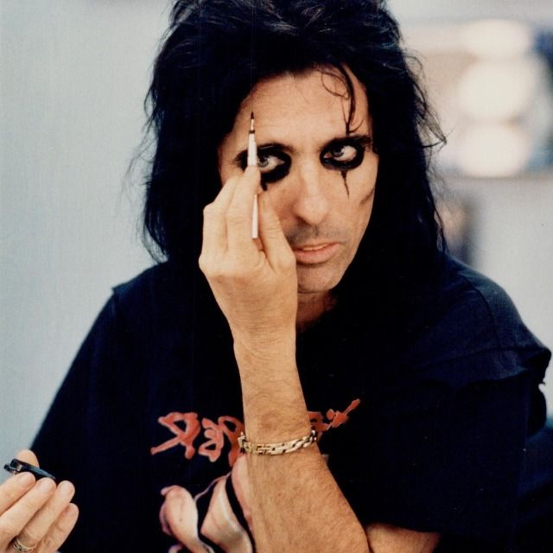
Alice Cooper

Slide 13

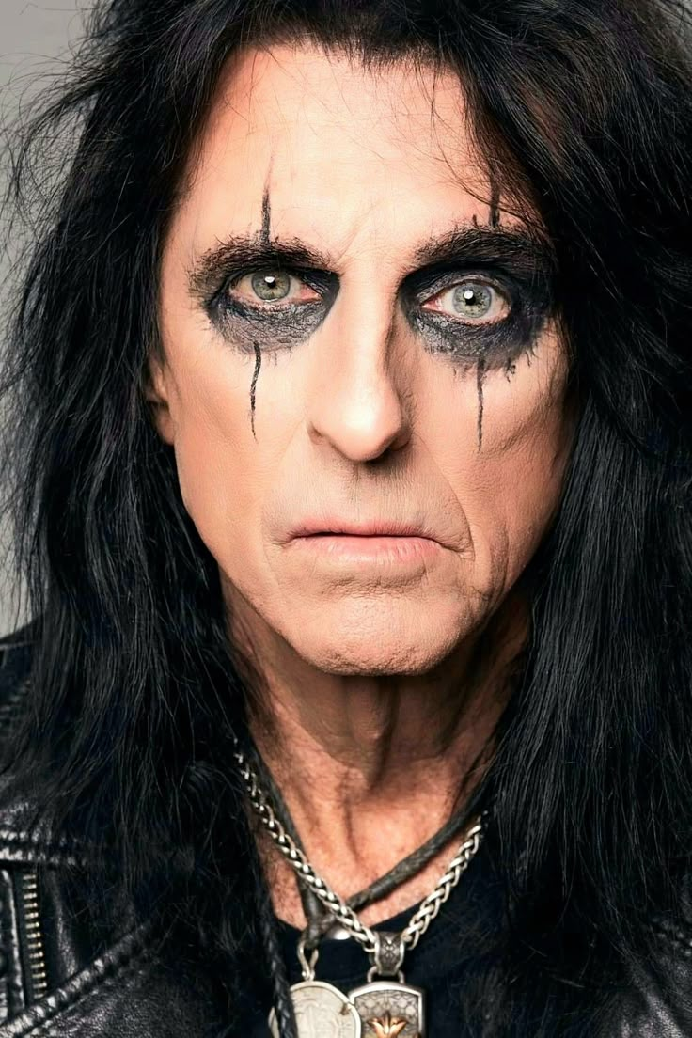
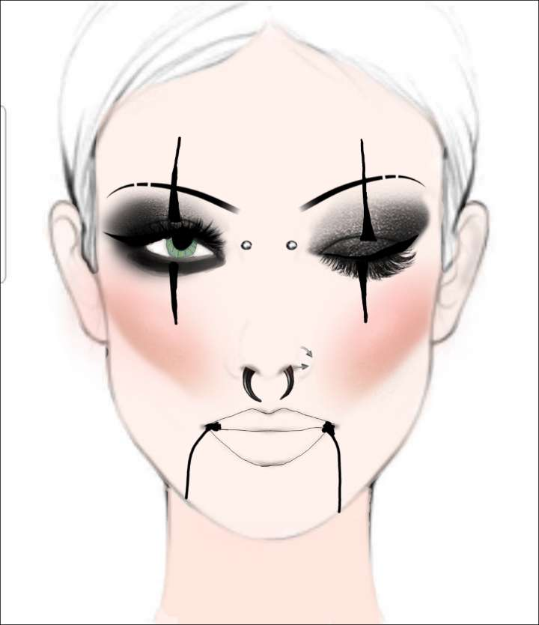
Who is Alice Cooper?
Alice Cooper (Vincent Damon Furnier) is a ‘Shock Rock’ musician.
Born in Detroit, 1948.
Started his first band in high school.
In the Rock N Roll hall of fame.
Inspired at a young age by The Beatles, The Rolling Stones and The Who.
Known for hits like Poison and School’s Out.
Notes:
Alice Cooper, otherwise known as Vincent Damon Furnier, is a rock musician from Detroit. He is known widely as the “Godfather of shock rock” and has even earned a place in the rock n roll hall of fame. Alice Coper started his first band in high school after years of being inspired by artists such as: The Beatles, The Rolling Stones and The Who. In one of his early bands, he was noticed by guitarist Frank Zappa who insisted that the band should b signed to a record deal and helped this become a reality with his connections in the industry. Alice cooper has always been seen as a very engaging frontman, he is known for his wild makeup and hots such as Poison and School’s out.

Slide 14
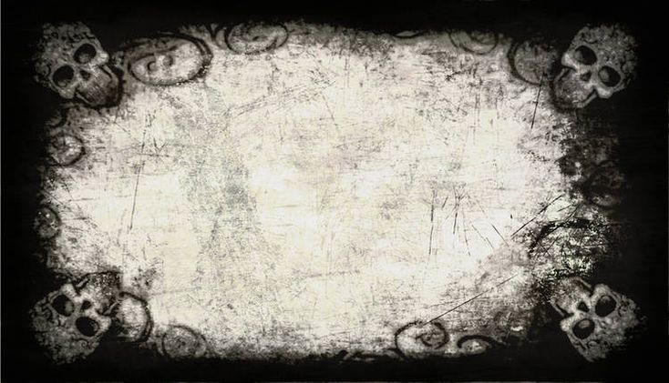
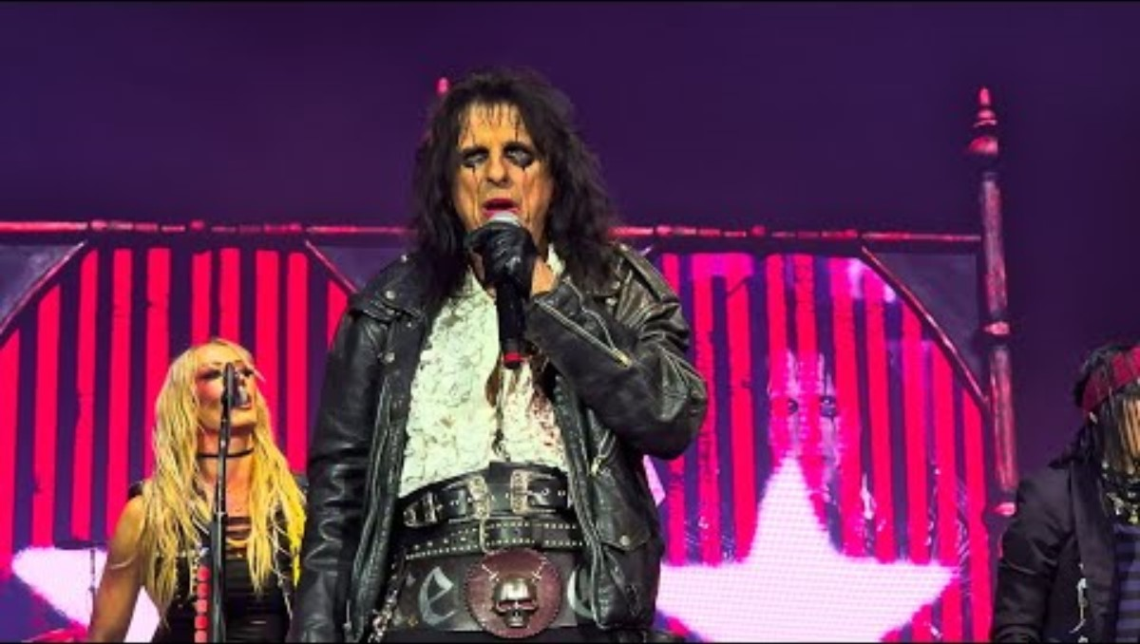

Slide 15
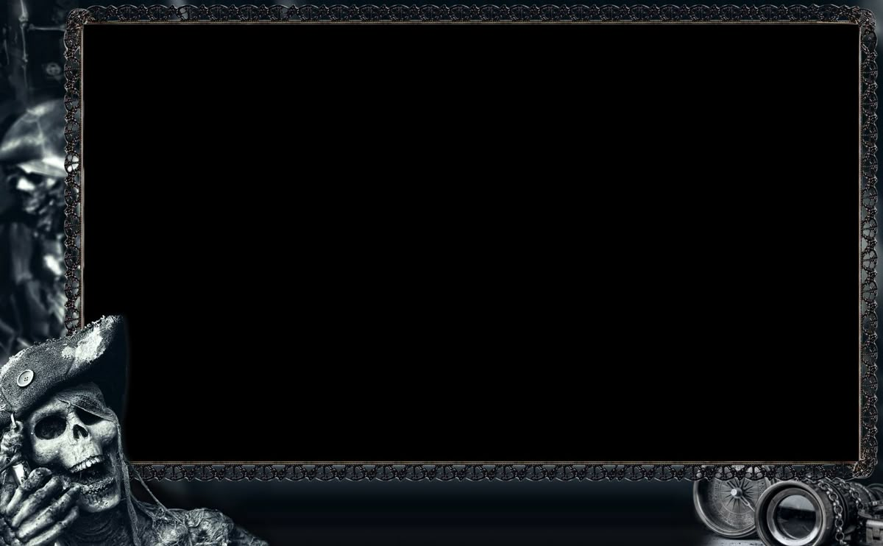
Stage Presence.
Dramatic performance, similar to a Musical play/Opera.
Unique costumes (vintage/pirate inspiration).
Use of props & Physical sets (like a play).
Does NOT use a mic stand.
Notes:
From this video, we can see that Alice Cooper delivers a very dramatic performance. This is laid out very similarly to a musical play or even an opera. Something else that adds to this is the costumes worn by the entire band and stage hands. The unique inspiration from vintage items and pirate like outfits adds to the performance because fans are also likely to dress in such attire. This became apparent when Alice cooper did a show in Toronto with Rob Zombie, Rob Zombie fans are known to dress in western outfits inspired by cowboys but in a rather gothic and zombie like sense while cooper’s fans were dressed in pirate attire. Alice cooper also uses a lot of props like swords and the giant poster at the beginning of the video, this further enhances the performance being like a play. He also does not use a mic stand. He is seen using a holster attached to his belt to hold his microphone when he is neither singing or talking. This allows him to move anywhere on the stage freely and have a microphone at all times.

Slide 16

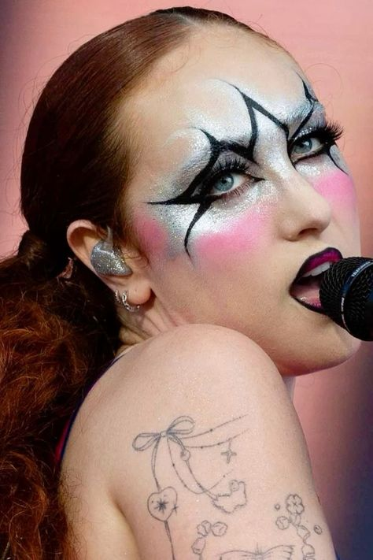
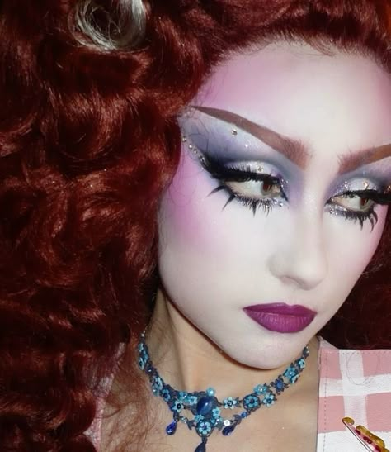
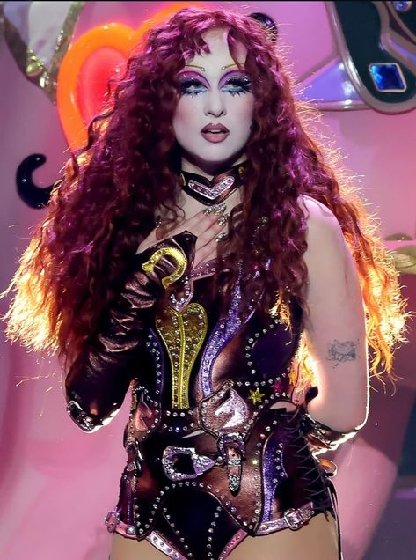
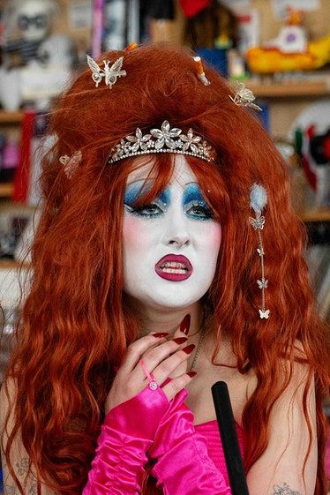
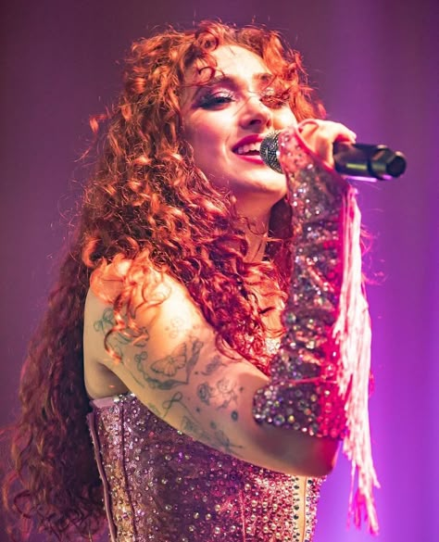
Chappell Roan

Slide 17

Who is Chappell Roan?
Chappell Roan, otherwise known as Kayleigh Rose Amstutz, is a Pop/Country singer from Willard, Missouri.
She is a Grammy-Nominated singer, known for hits like ‘Pink Pony Club’ and ‘Hot To Go’.
Her songs discuss her sexuality and relationships.
Chappell Roan is Kayleigh’s drag queen persona.
Sasha Colby is her drag mother.
Influenced by queer culture, drag culture and the empowerment of the LGBTQIA+ community.
Notes:
Chappell Roan is a pop/cuntry singer from a town called Willard in Missouri. Her real name is Kayleigh Rose Amstutz and she is a grammy nominated vocalist known for hits like Hot To Go, Pink Pony Club and Good Luck Babe. Chappell is actually Kayleigh’s drag persona. She was made aware of this while doing a show with a drag queen support act. Sasha colby (starred on RuPaul’s Drag Race) is Chappell’s Drag mother. And Chapell has stated that she is very influenced by queer culture and the drag community. This is apparent in her songs where she talks about her experiences in relationships as a lesbian.

Slide 18

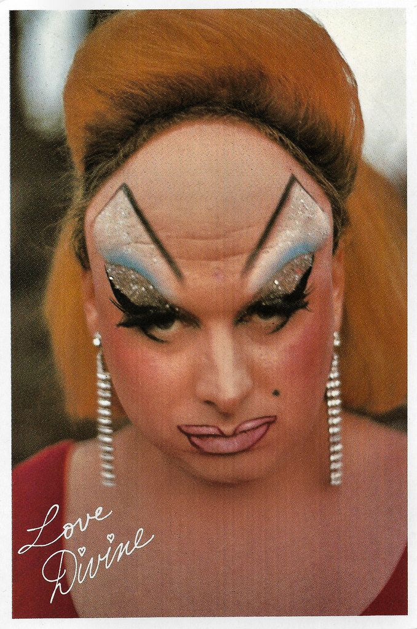
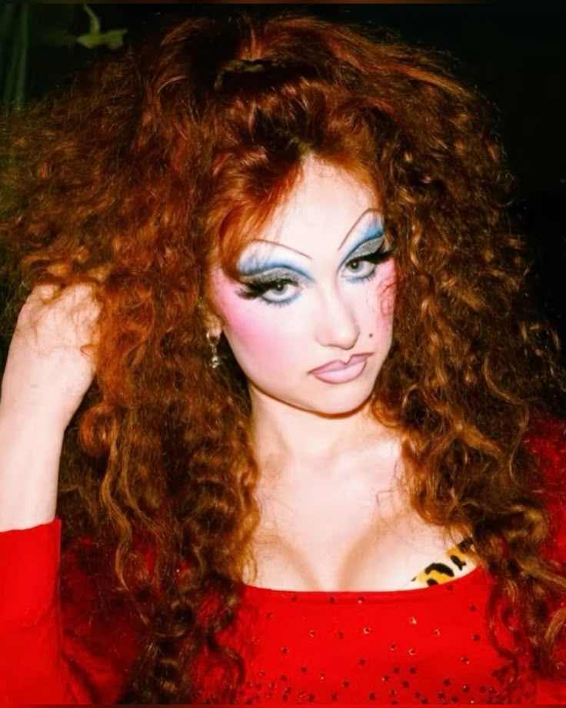
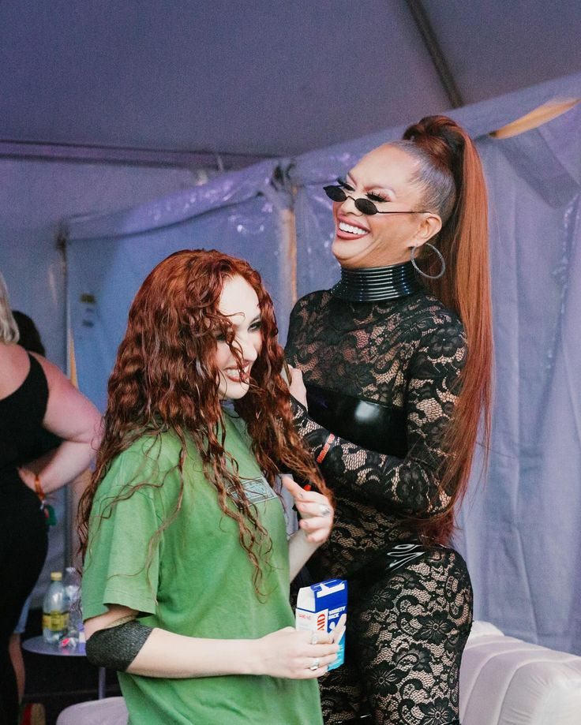
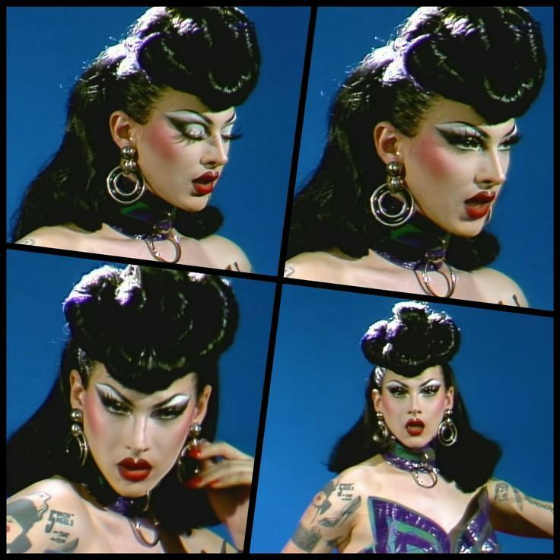
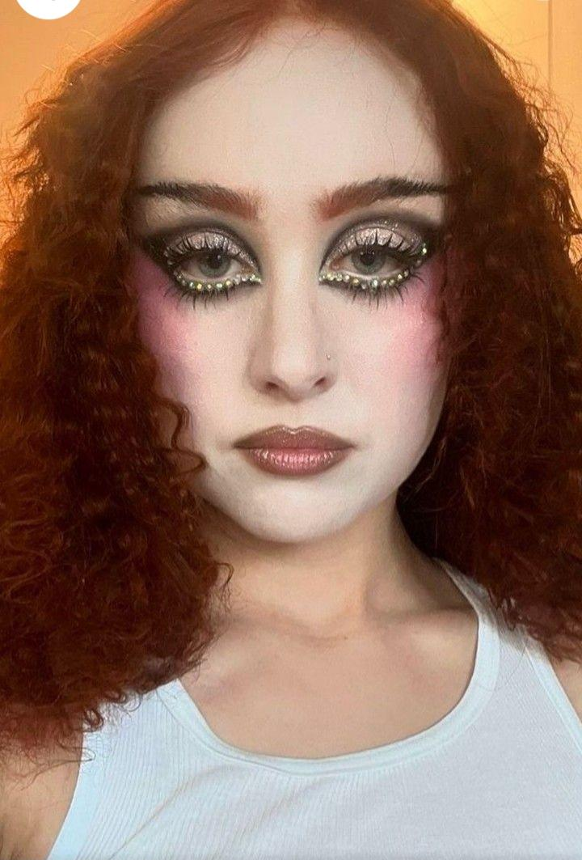


Why is drag her influence?
A drag queen is a performer (dancer, actor, vocalist) that dresses in clothing and adopts some characteristics that are exaggerated, typically from the opposite gender.
Many pop culture icons are inspired by drag artists, including Shania Twain and Lady Gaga.
"It's been very freeing" - Chappell talking about how realising she was a drag queen felt.
Notes:
What is a drag queen?
Drag queens have inspired and helped shape pop culture. Artists including Shania Twain and Lady Gaga

Slide 19

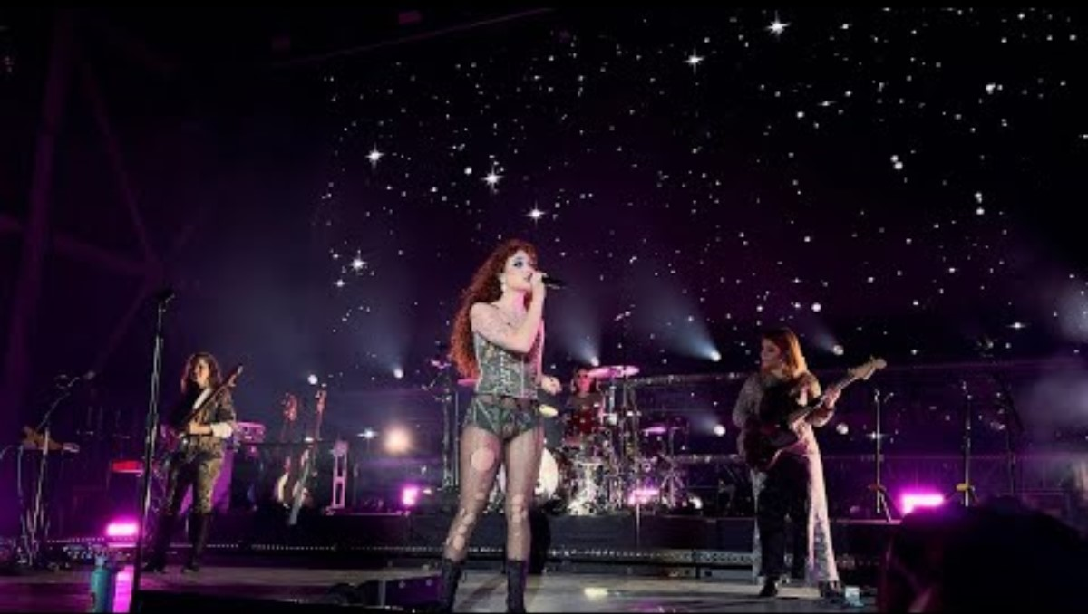

Slide 20

Stage presence.
Chappell's backing band reciprocate her energy on the stage.
Very high energy performance.
Great audience interaction.
Lots of confidence.
Notes:
This video is a perfect example of why stage present is important for an entire band as well as the vocalist. The crowd went absolutely crazy for the guitarist's improvised solo and they are part of a backing band. Chappell Roan herself is very entertaining to watch because of her energetic moves on stage as well as her over exaggerated actions to display the emotion of the song. I this this is a perk of her drag persona as she is allowing herself to freely express emotion with her songs that hold such deep and personal meanings.

Slide 21
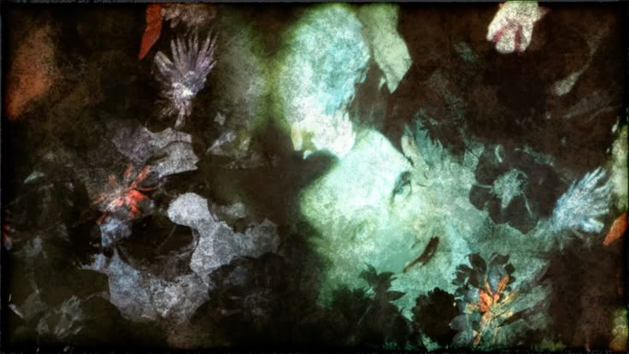
Thanks for listening! :)

